Slide 1
ASTROPHYSICS Yr 2
Presented this year by Dr. Keith Robinson
Keith’s email:
k.robinson@salford.ac.uk
All course materials will be available on Blackboard

Slide 2
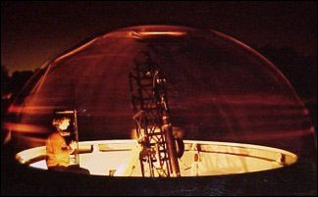
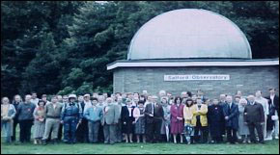
Try to see the night sky
through a real telescope
www.salfordastro.org.uk
Salford Observatory: Chaseley Field,
Chaseley Road, Salford (entrance opposite number 12)
Salford Astronomical Society
Observatory Open Nights
1st Wed. in month 7.30pm
Eg. Oct 5th, Nov 2nd etc.

Slide 3
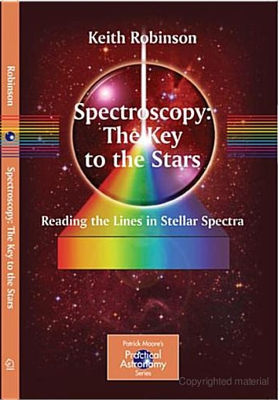
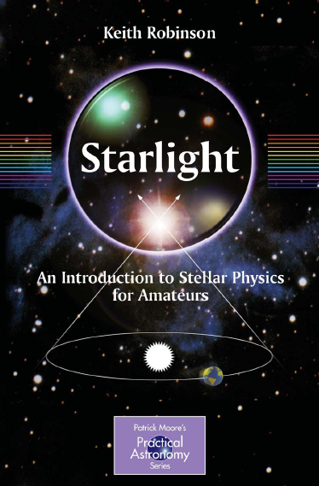
These might help

Slide 4


Slide 5

Astrophysics – the Physics of the
Universe

Slide 6
Why do physicists get interested
in astrophysics?

Slide 7
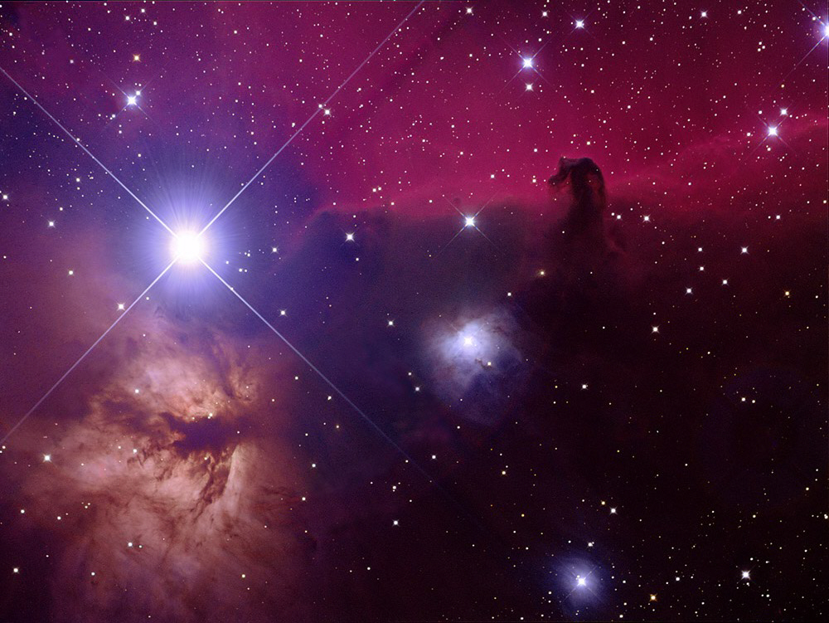
The astrophysicist’s laboratory!

Slide 8
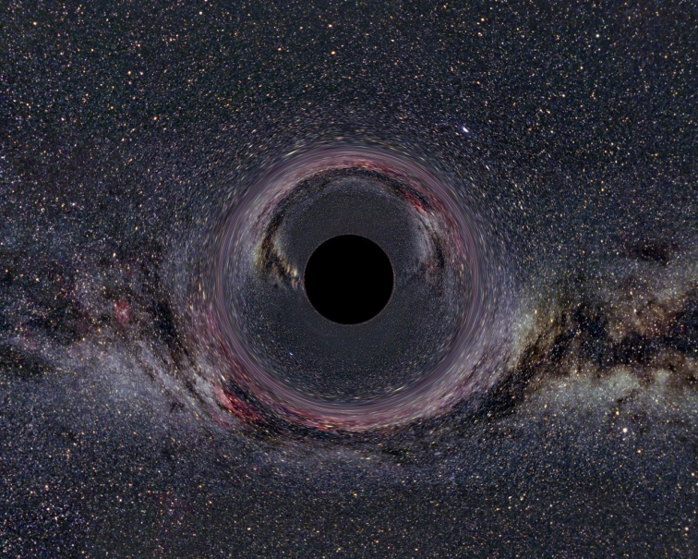
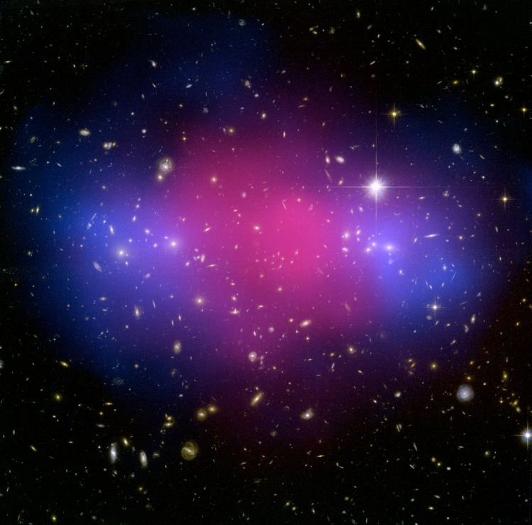
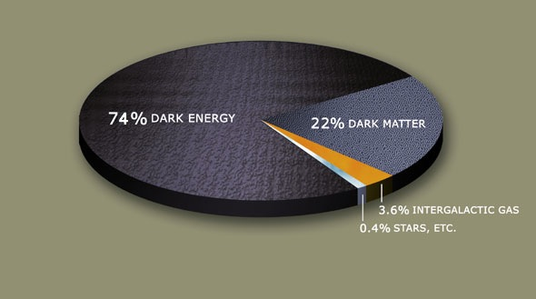
Exotic physics
Black holes
Dark matter & dark energy

Slide 9
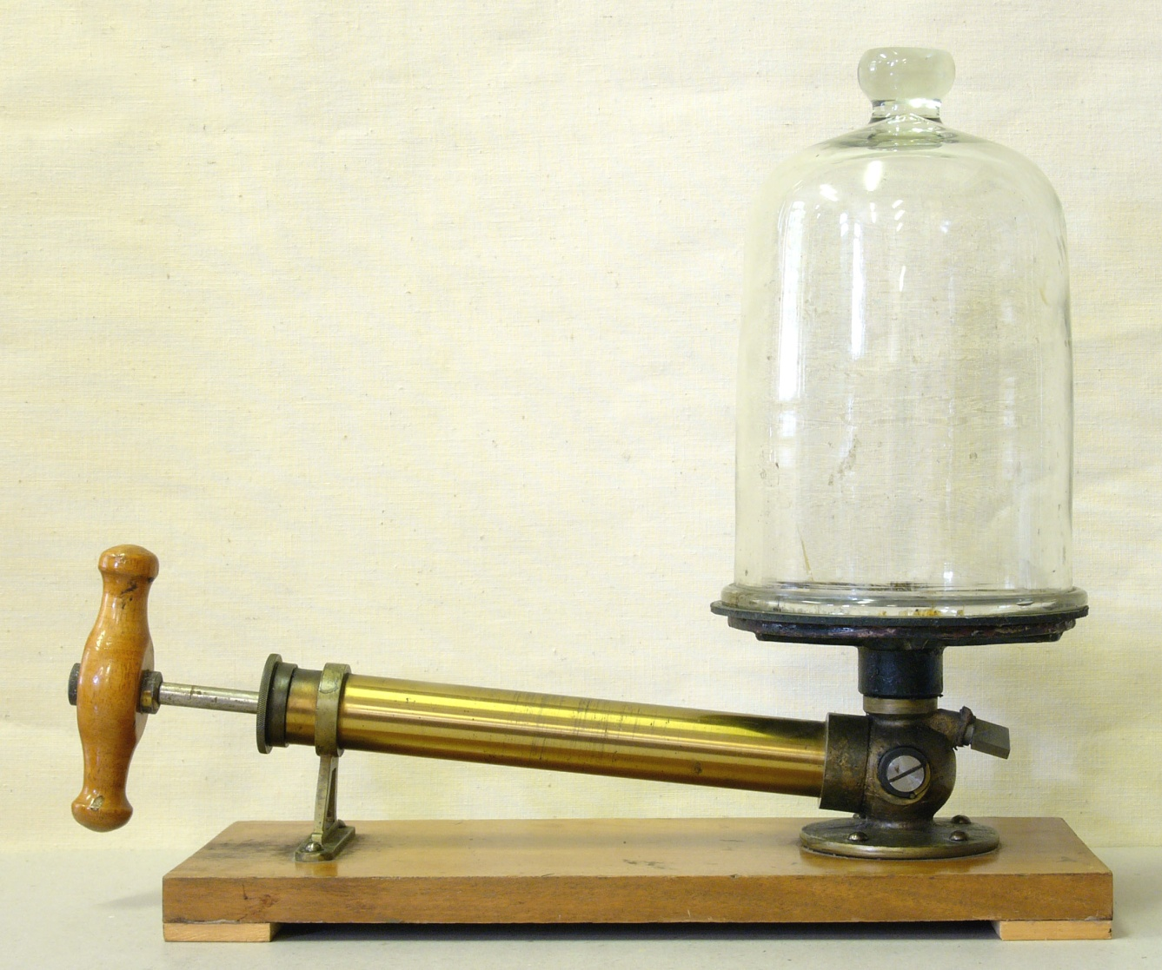
Extremes conditions; e.g. of low density
Best lab vacuum – 10¹¹ particles per m³

Slide 10
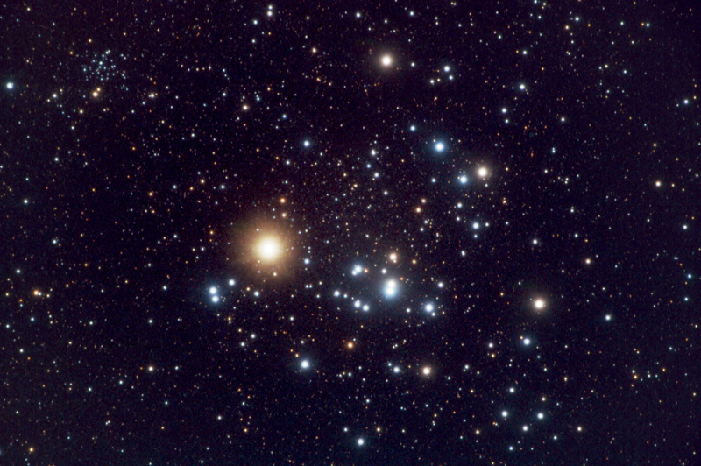
Interstellar space – 10⁶ particles per m³

Slide 11
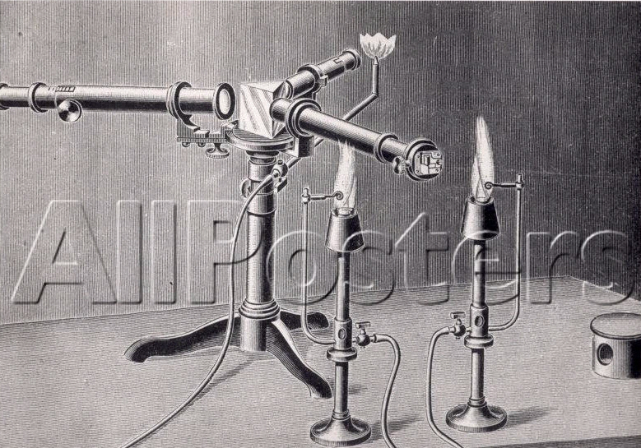

Spectroscopy in the lab
Extremes of scale; e.g. spectroscopy in the lab

Slide 12
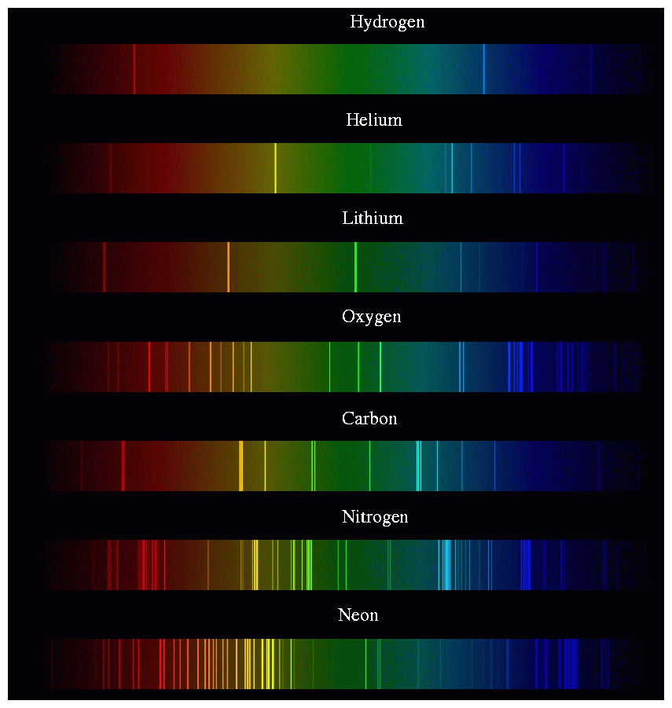
Physics lab
spectra

Slide 13
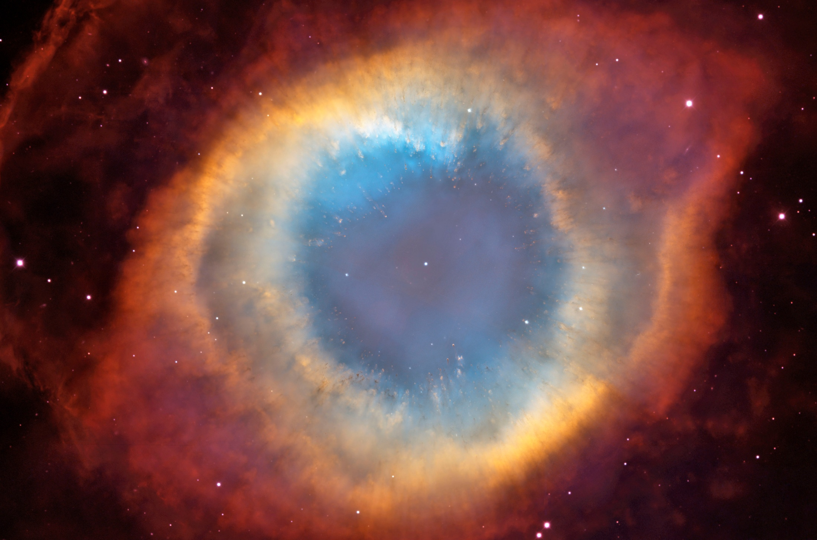
A stellar remnant
∼ 1 light year

Slide 14
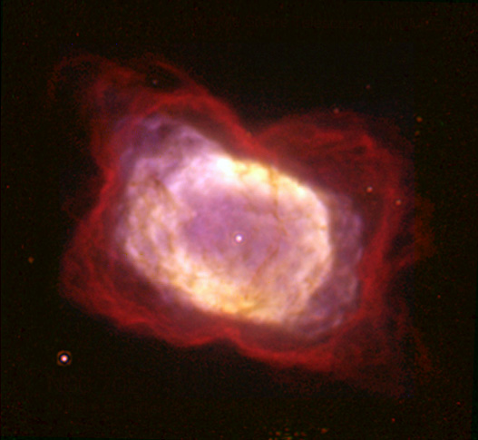
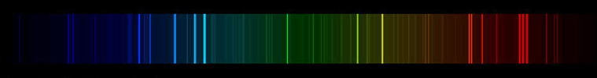
Stellar remnant NGC7207
& its spectrum
Forbidden lines due to doubly ionised oxygen

Slide 15
What we shall learn about

Slide 16
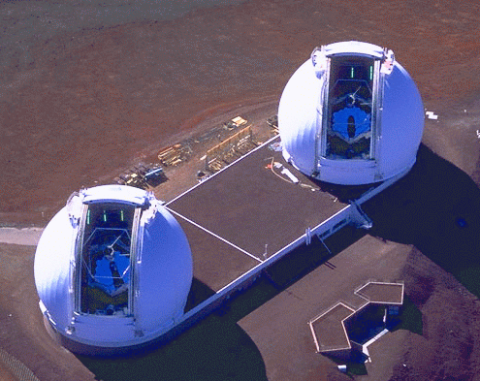
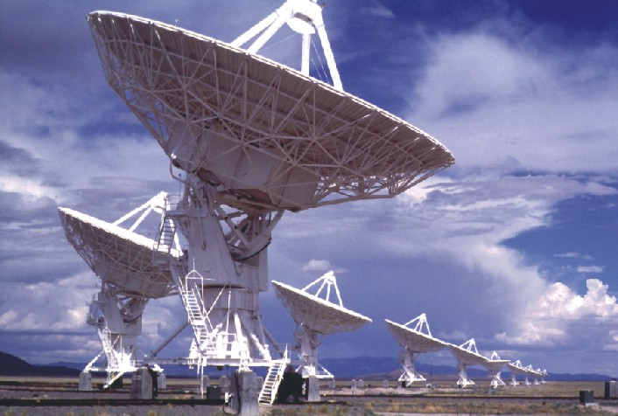
Telescopes
Hi-tec & very expensive
but their basic function
is really quite simple

Slide 17
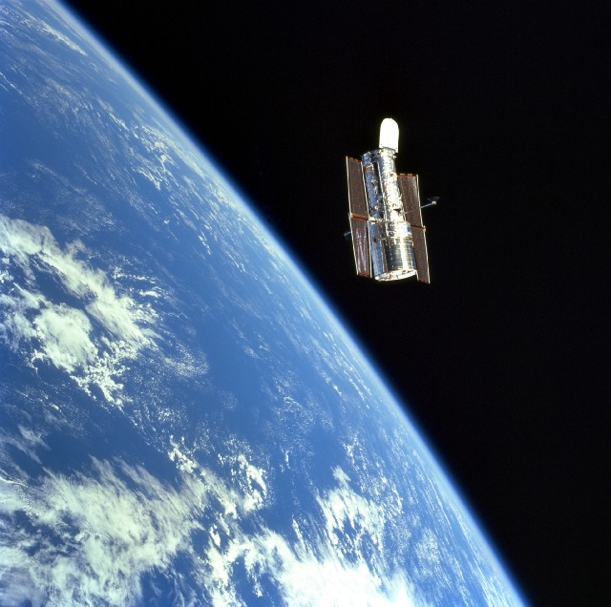
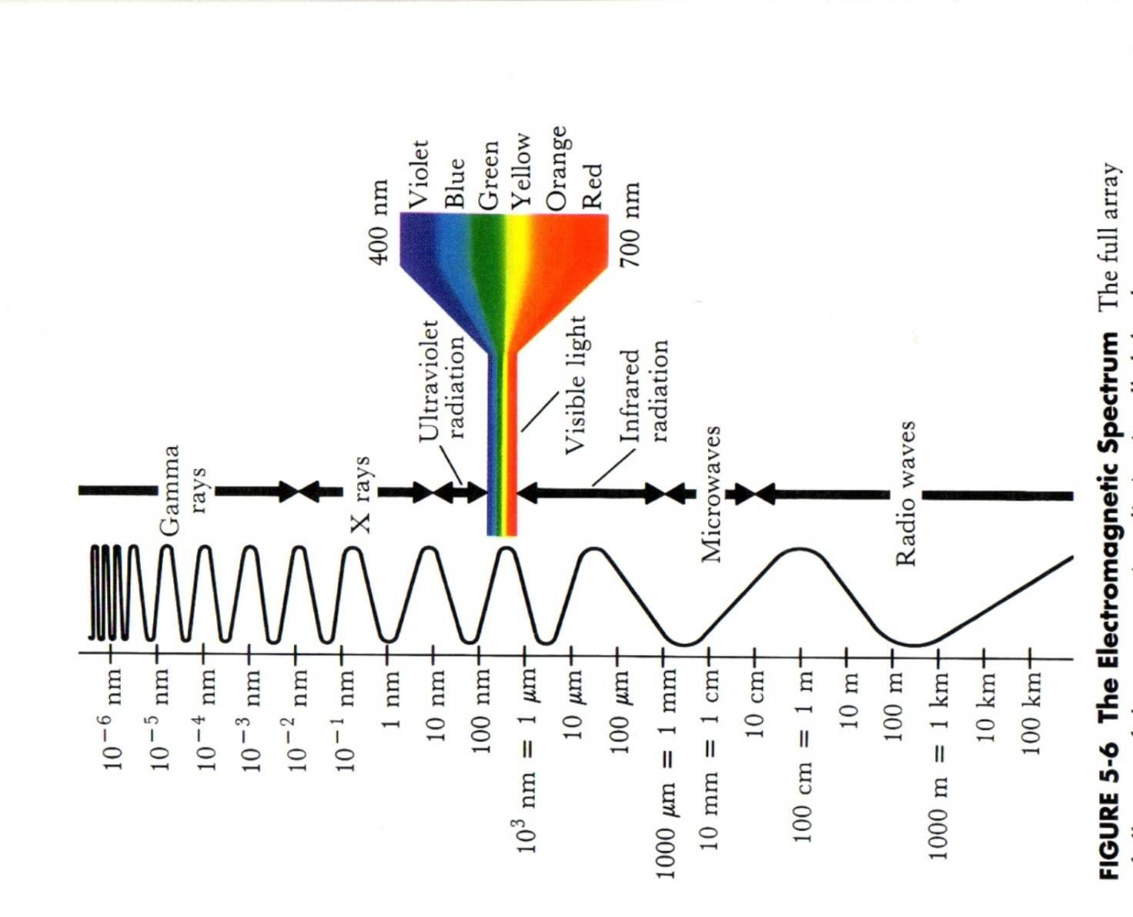
e-m Radiation
Astronomers now observe at virtually all wavelengths

Slide 18
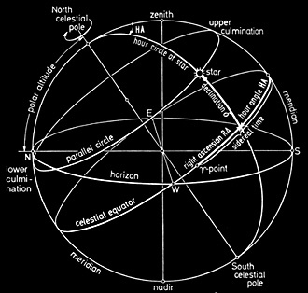
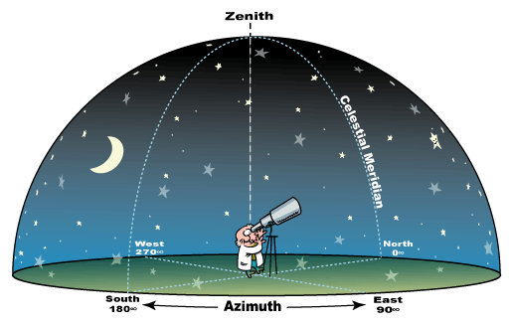
How the Night Sky ‘Works’

Slide 19
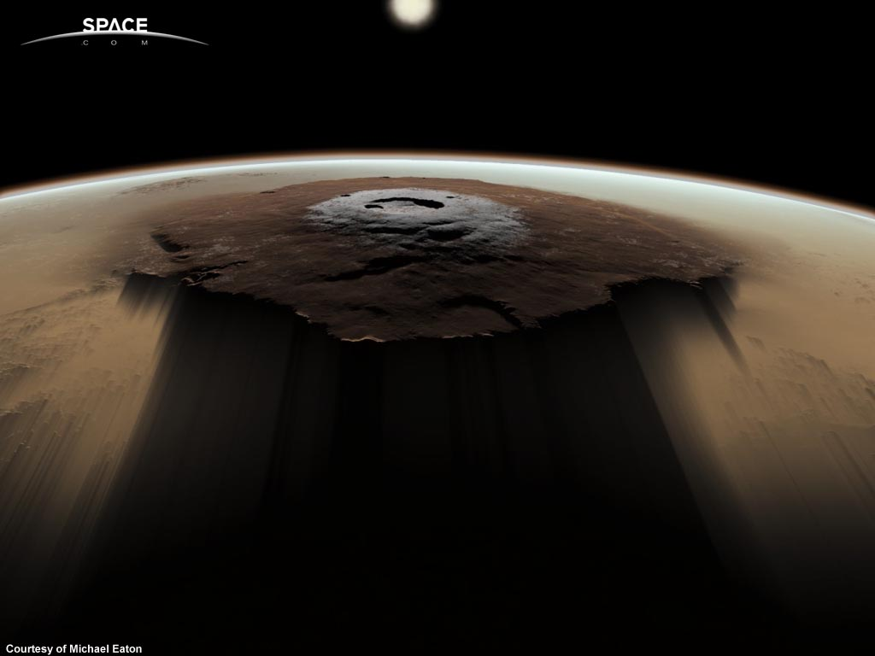
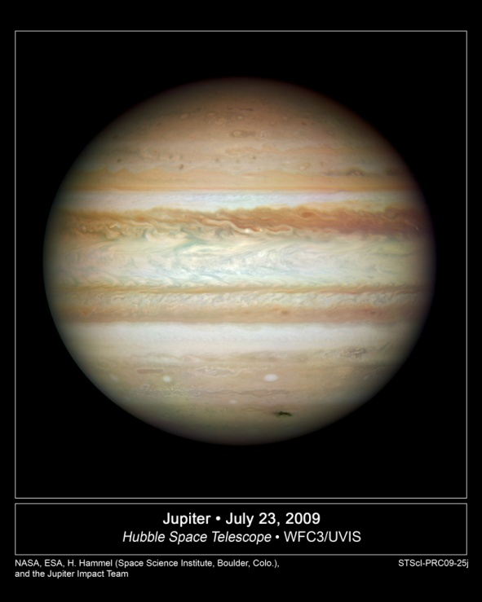
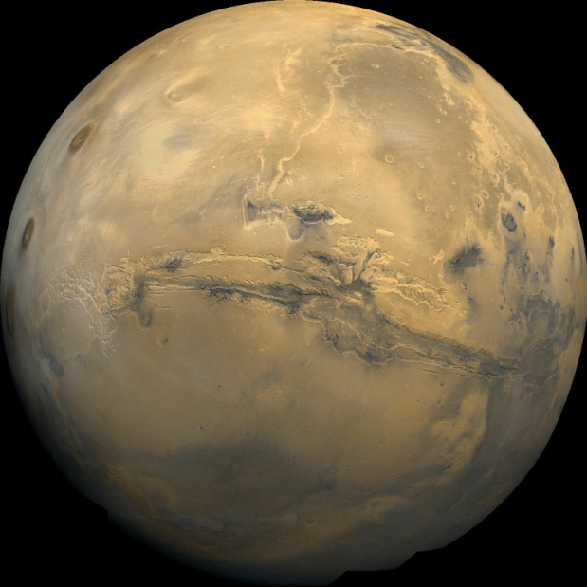
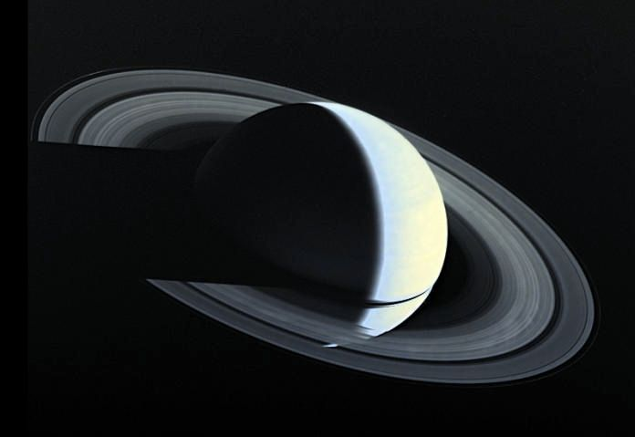
The Solar System
But not too much;
More a subject for
Planetary scientists.

Slide 20
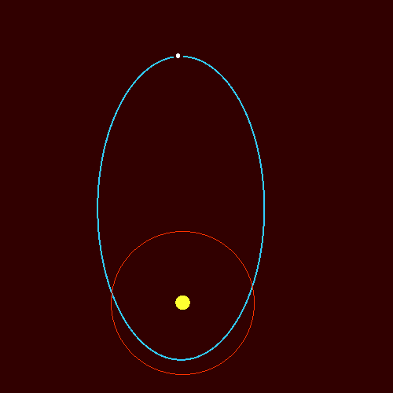
Orbits & Kepler’s Laws

Slide 21
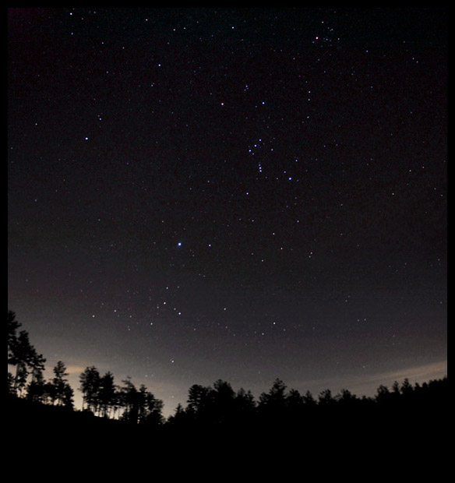
The physics of stars

Slide 22
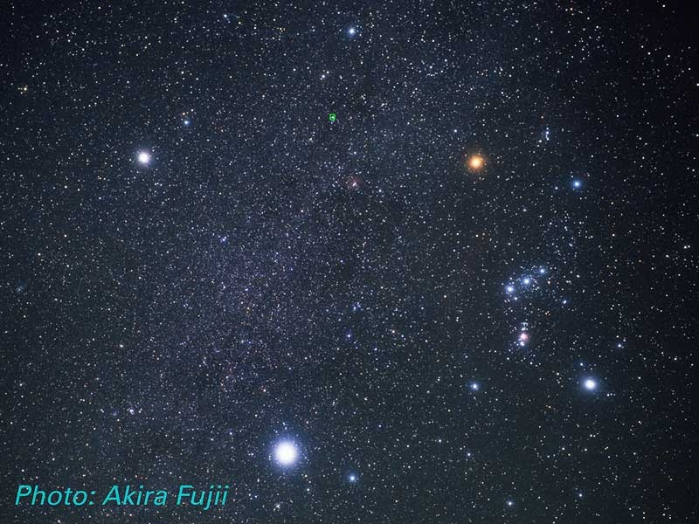
Observational properties; e.g. brightness & colour

Slide 23
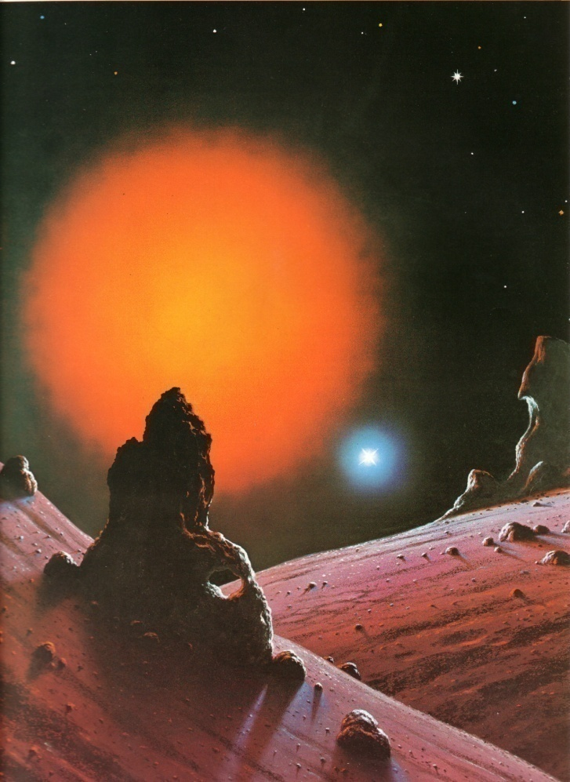
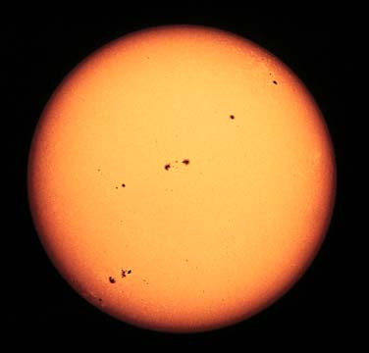
Stars as suns…
…including our own

Slide 24
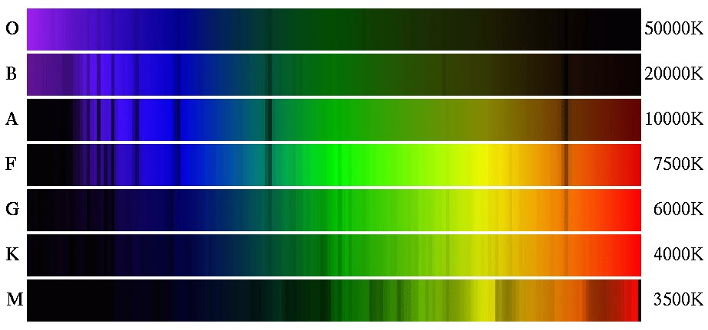
Astronomical spectroscopy
Typical stellar spectra

Slide 25
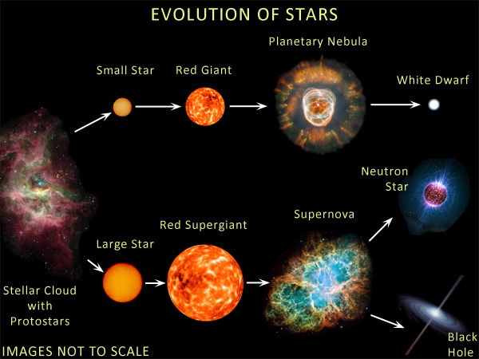

Slide 26
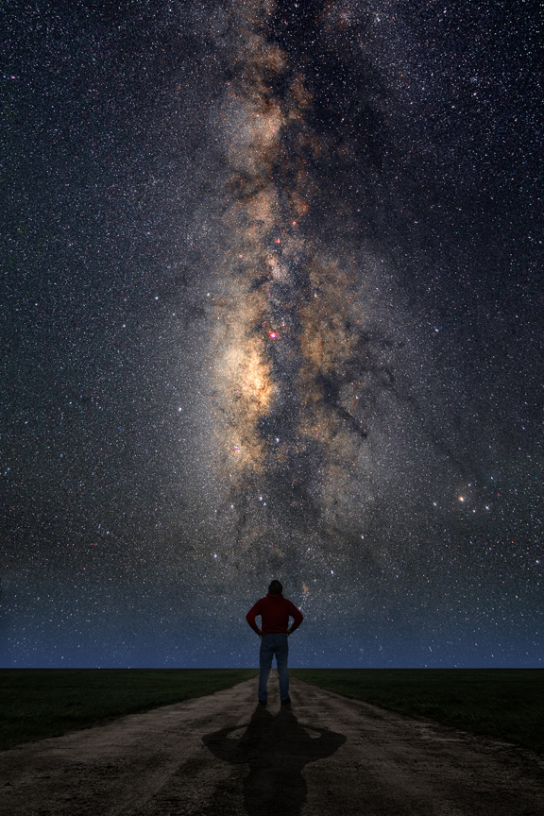
Our Galaxy – the Milky Way…

Slide 27
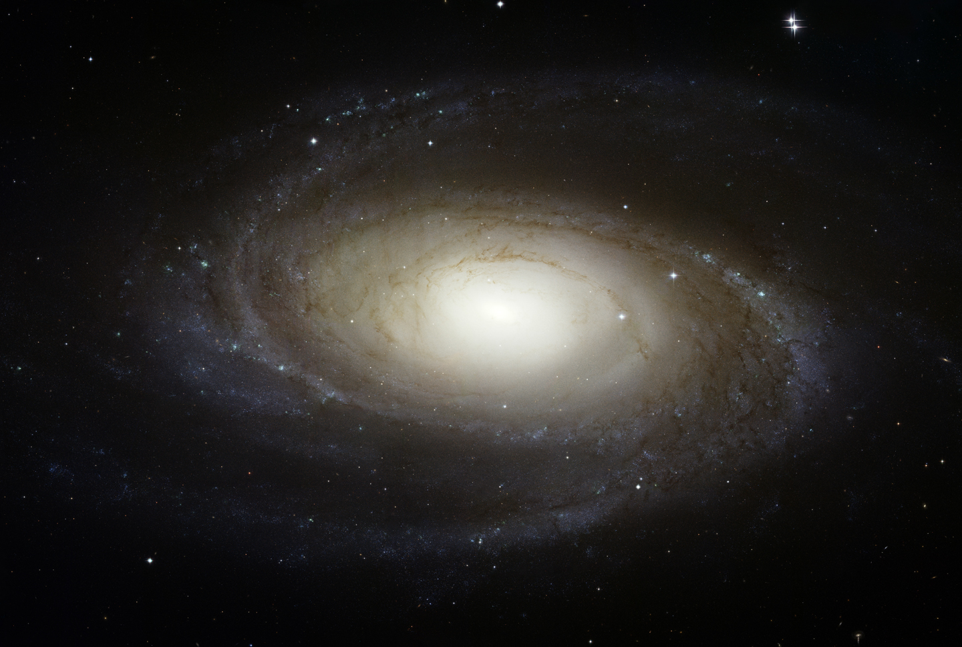
…and other galaxies

Slide 28
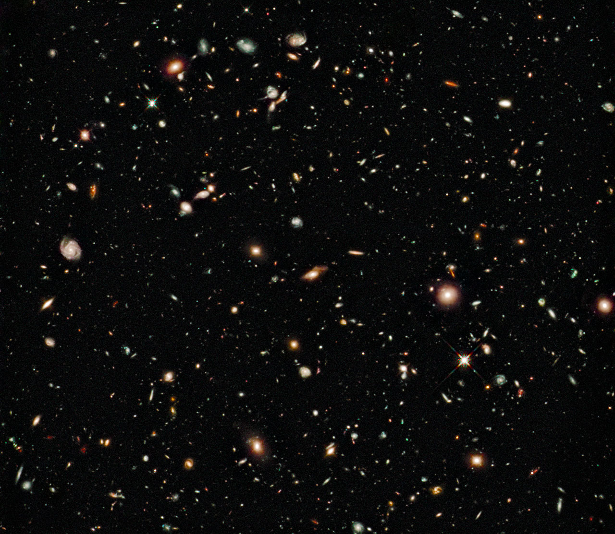
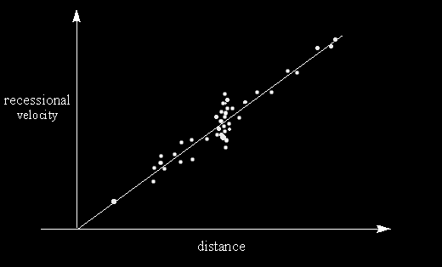
Cosmology – the Big Picture
Hubble Deep Field

Slide 29
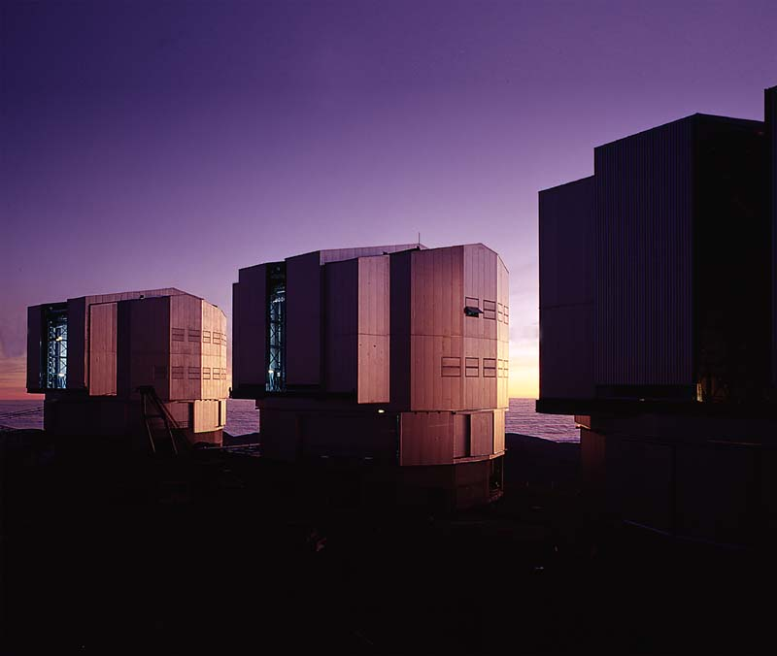
ASTROPHYSICS Yr 2
Session 1 - Electromagnetic Radiation & Astronomical Telescopes

Slide 30
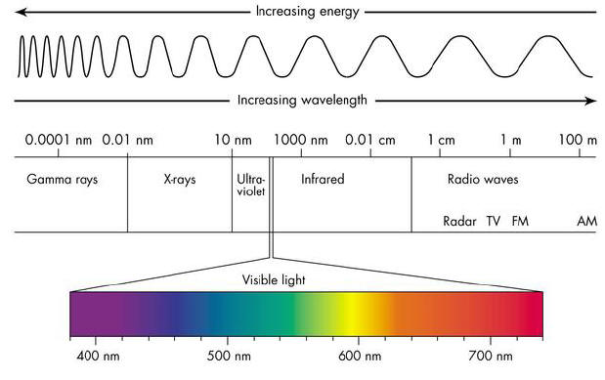
The Electromagnetic (e-m) Spectrum
c = νλ
Astronomers always plot spectra this way – i.e. with wavelength increasing to the right (physicists often plot spectra the other way round, with frequency; i.e. energy increasing to the right).

Slide 31
Typical physics lab spectra

Slide 32
Typical stellar spectra

Slide 33
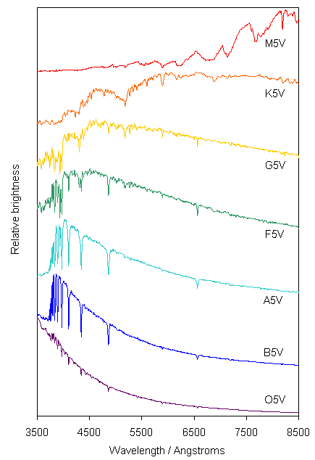
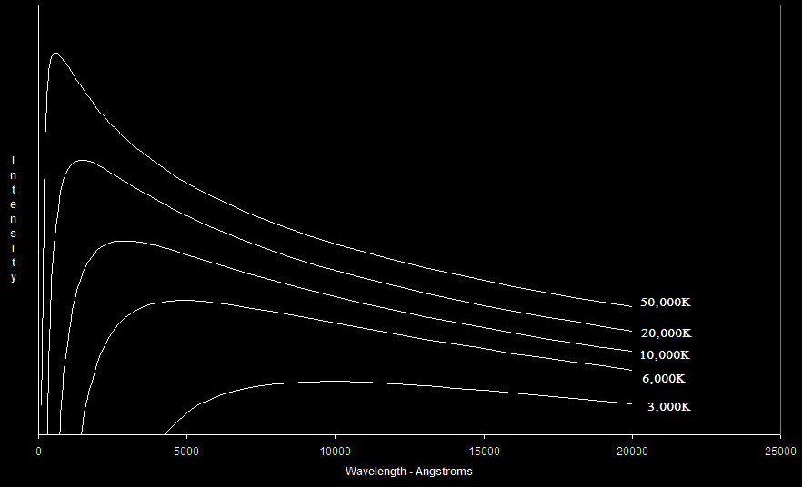
Plotted as
intensity vs. wavelength
they strikingly resemble
black body spectra.

Slide 34
E-M Spectrum Units
High energy end (γ rays, X rays) – Electron volts – see below.
UV/Optical/IR – nanometres(10⁻⁹m) or Angstroms (Å – 10⁻¹⁰m).
Far IR/Sub mm – microns (10⁻⁶m).
Microwave – mm.
Radio – metres and maybe also frequency (kilo Hertz) at long wavelength end.
Note:
It is common practice in astronomical literature for wavelengths in Angstroms – eg. 6563Å to be written as λ6563 and a range of wavelengths to be written for example as; λλ3000-5000.

Slide 35
Photons – Quantum treatment of e-m radiation.
E = hf = hc/λ Energy E – joules
Planck’s constant h = 6.626 × 10⁻³⁴ joule sec.
Frequency f – sec⁻¹
Speed of light c = 2.998 × 10⁸ m/sec
VERY IMPORTANT! – Always convert wavelength λ to metres – eg. 5000Å = 5 × 10⁻⁷ m.
Conversely using the above equation to derive a wavelength will result in λ in metres; this can then be converted to Angstroms, nanometres etc.

Slide 36



Electron Volt (ev) = 1.602 × 10⁻¹⁹ joule
Example: Energy in ev of 5000Å photon (green light)
5000Å = 5 × 10⁻⁷ m
E (joules) =
To avoid silly mistakes, rearrange an equation like this to look like this:
E =
×
E = 3.973 × 10⁻¹⁹ joule
Divide this by 1.602 × 10⁻¹⁹ to give: E = 2.48 ev.

Slide 37
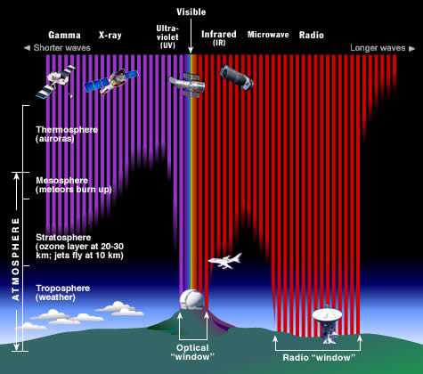
The Astronomer’s E-M Spectrum
Most e-m radiation is absorbed by the Earth’s atmosphere and does not reach ground based observatories.

Slide 38
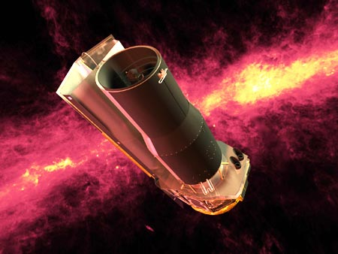
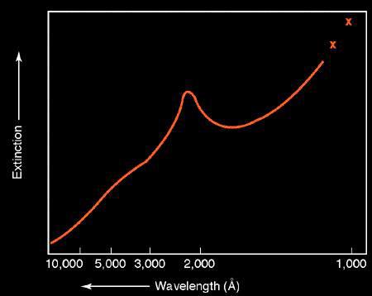
Astronomers now observe in almost all regions of the e-m spectrum by using space borne observatories in addition to those on the ground.
The λ2200 Extinction Bump:
UV radiation covering approx.
λλ1900-2500 suffers extra
absorption in interstellar space
thought to be due to particles
of graphite and possibly
Buckminster fullerene.

Slide 39
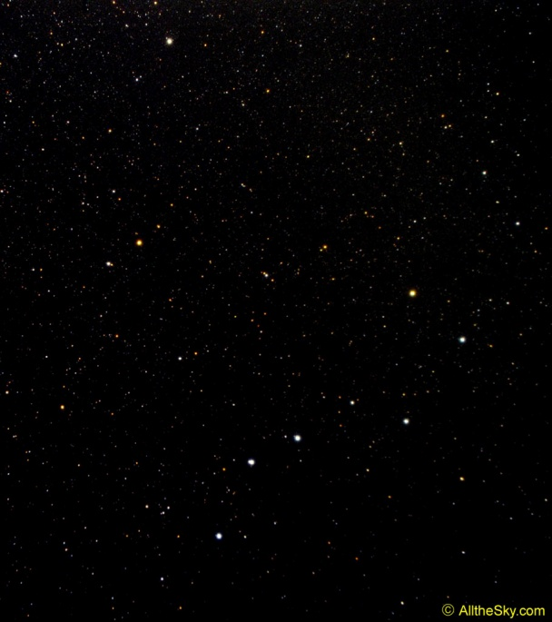
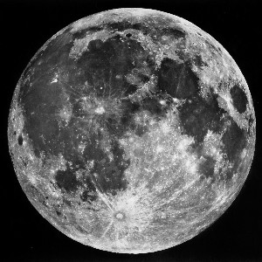

Measuring Distances on the Sky
Irrespective of the actual distance between for example, two stars, they have an apparent ‘separation’ on the background sky. This is measured by the angle between the two lines drawn from the stars to the observer and is referred to as the angular separation.
θ
30 arcmin
5°
θ is of course measured in degrees but in astronomy, angles smaller than one degree are measured in arcminutes (or arcmin or ‘ = 1/60 of one degree) and arcseconds (or arcsec or “ = 1/60 of 1 arcmin = 1/3,600 of one degree). For example, the angular separation of the pointer stars in the Plough is about 5°.
This system is also used when referring to the angular diameters of extended objects; eg. the angular diameter of both the sun and the Moon is about 30 arcmin.

Slide 40
Optical Astronomical Telescopes
They do three things:
} Most important
Collect light
Resolve fine detail
Magnify
Less important

Slide 41
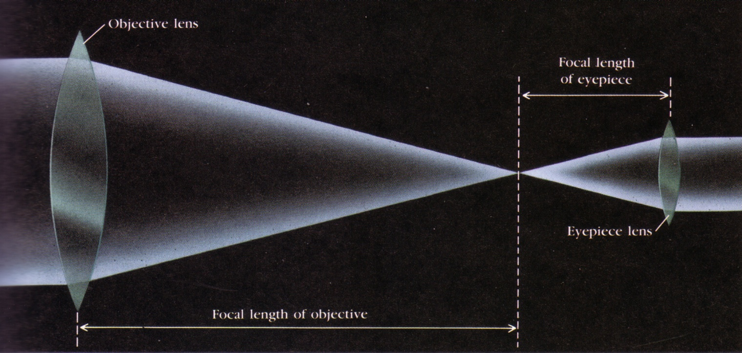
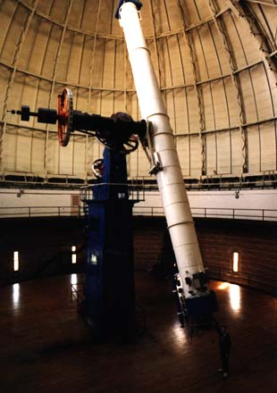
Light Gathering
Done by the telescope’s objective –
Refractors use a lens (not used in modern professional observatories).

Slide 42
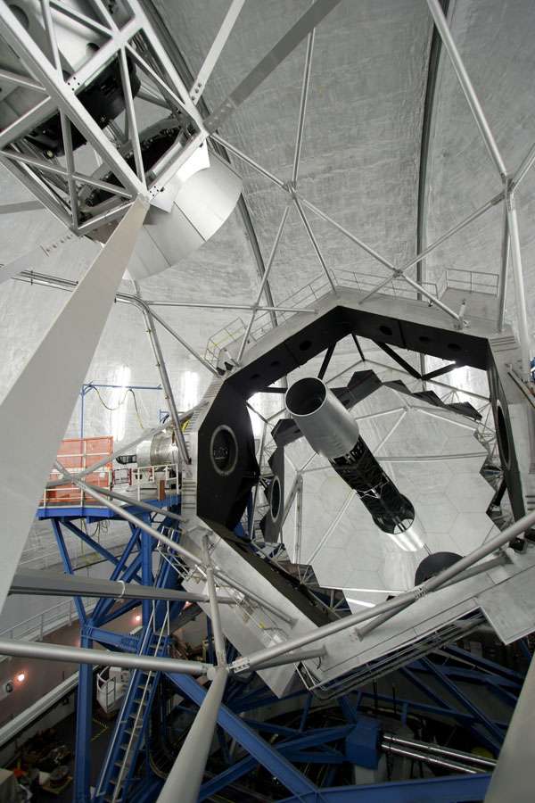
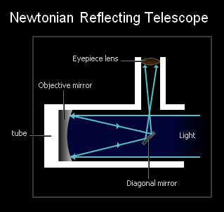
Reflectors
use a parabolic mirror – All modern professional observatories use reflectors.

Slide 43
Telescope Terms
Telescope aperture – d; The bigger this is, the more light you collect.
Focal length – f; the distance between the objective and the point where the image is formed by it. This determines the telescope’s focal plane scale – see below.
Focal ratio – F = f/d (f and d in the same units).

Slide 44

Light gathering power –
determined by area of objective; = π × (d/2)² = πd²/4.
Example:
Maximum diameter of (dark adapted) human eye ≅ 10mm; objective diameter of typical amateur telescope = 200mm. So ratio of light gathering power of the telescope to naked eye is:
= 400
I.e. the amateur astronomer’s humble telescope can detect objects which are 400 times fainter than the naked eye. We shall see later in the course how this ‘translates’ into what we might actually expect to see with such an instrument.

Slide 45
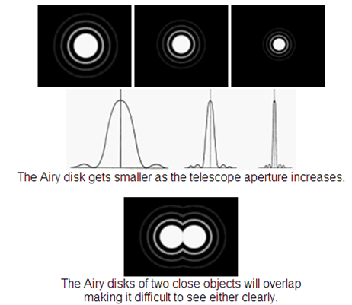
Resolving Power
This is how a telescope ‘sees’ stars; i.e. as circular diffraction patterns. The central spot of such a pattern is called the Airy disc and the resolving power of a telescope is defined by the radius R of the Airy disc.
Remember this formula:
R = 1.22 × λ/d R in radians
206265 × 1.22 × λ/d
= 251643 × λ/d
⇨ R in arcsec.
The Airy discs of two stars whose separation is R are just resolved.
Note; R improves for shorter wavelengths

Slide 46


Example
20cm(0.2m) back garden telescope observing at λ5000.
R = 251643 ×
= 0.629 arcsec.
Without the use of adaptive optics, atmospheric turbulence means that this resolution is virtually never achieved with ground based telescopes.

Slide 47

The star Betelgeuse & the effect of atmospheric turbulence → ‘twinkling’.

Slide 48

Magnification
Only relevant for visual observing; i.e. with an eyepiece.
Magnification =
More important is focal plane scale.

Slide 49
Focal Plane Scale
Objective
= angular size
of object
f
θ
θ
h
206265/f arcsec/mm
h(mm) = f(mm) × θ(radians)
206265 × h(mm) = f(mm) × θ(arcsec)
Focal plane scale = (θ/h) arcsec per mm = 206265/f

Slide 50
Example
F = 1200mm
Fps = 206265/1200 = 171.9 arcsec/mm.
Apparent angular diameter of Moon ≅ 1800 arcsec.
So diameter of moon’s image at focal plane = 1800/171.9 ≅ 10.5mm.
The focal pane scale enables an astronomer to determine how big an area of sky can be imaged with a CCD of a given size.

Slide 51

Aberrations
Chromatic aberration
A single lens used as the objective for a refracting telescope would act like a prism as well as a lens. Light rays of different wavelength would be brought to a focus at different points; the image of a star would appear as a multicoloured mess. The problem is cured by having an objective made of two components (the result is called an achromatic objective) each made of different and very carefully matched pieces of glass.

Slide 52

Spherical Aberration
A problem for reflectors. Light rays striking the periphery of a spheroidal mirror come to a focus which is different to those striking the central region of the mirror. The cure is to deepen the curve on the mirror so that it has a parabolic shape. Catadioptric telescopes do use a short focal length spheroidal mirror but the spherical aberration is removed by the corrector plate in a not too dissimilar way in which the initial aberration problem with the Hubble telescope was fixed.

Slide 53

Next time:
The Celestial Sphere

