Slide 1
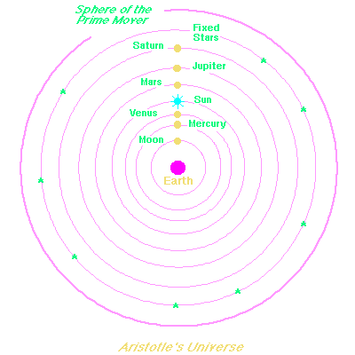
ASTROPHYSICS Yr 2
Session 2– The Celestial Sphere & Spherical Astronomy
Notes:
Still uses the Ancient Greek idea that the Earth id the centre of everything.

Slide 2
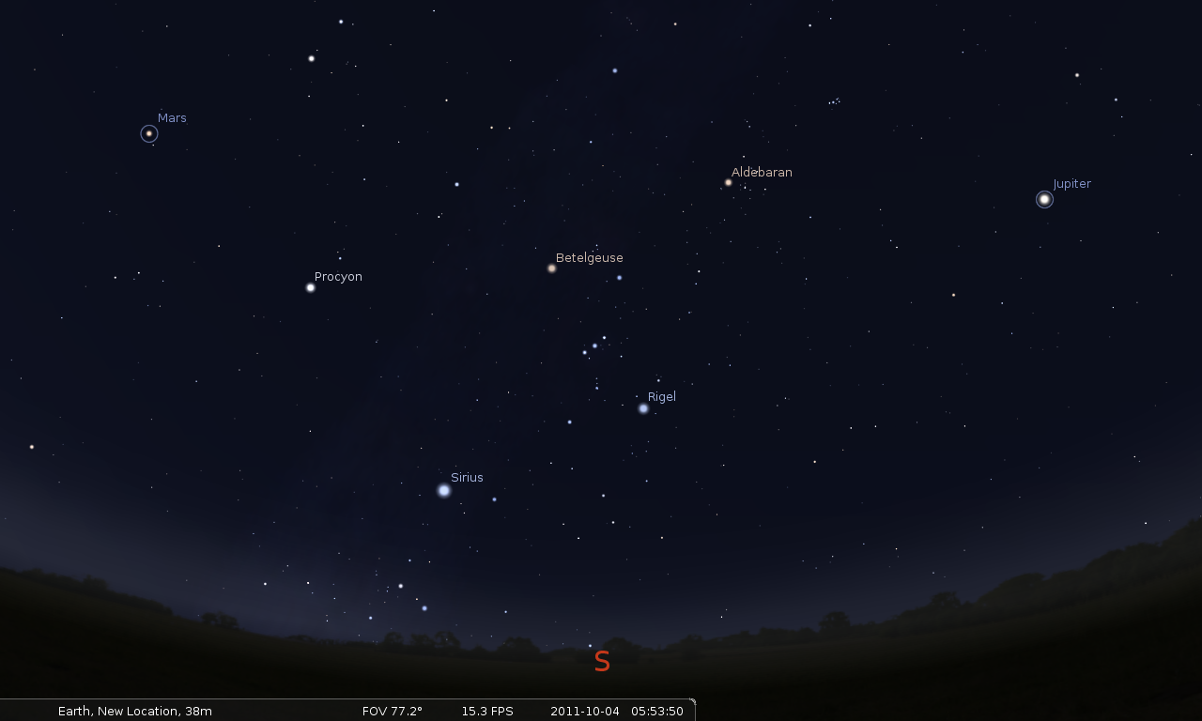
www.stellarium.org

Slide 3
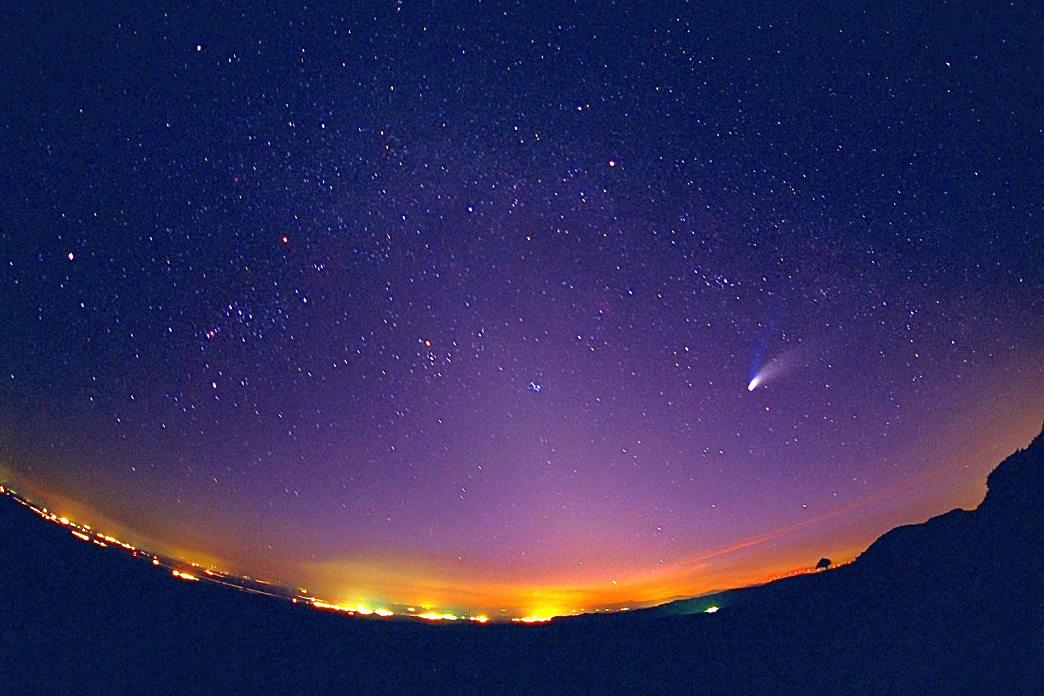
The Celestial Sphere
Notes:
Objects on the celestial sphere move around on it in cvarious ways.

Slide 4

North
Celestial Pole
Celestial Equator
South
Celestial Pole
Notes:
The basic set up

Slide 5
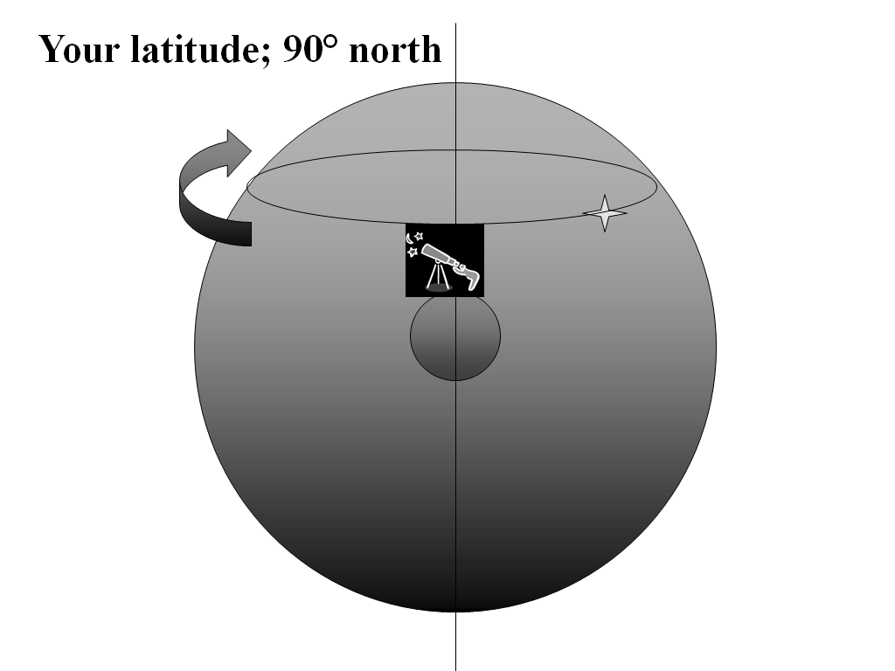
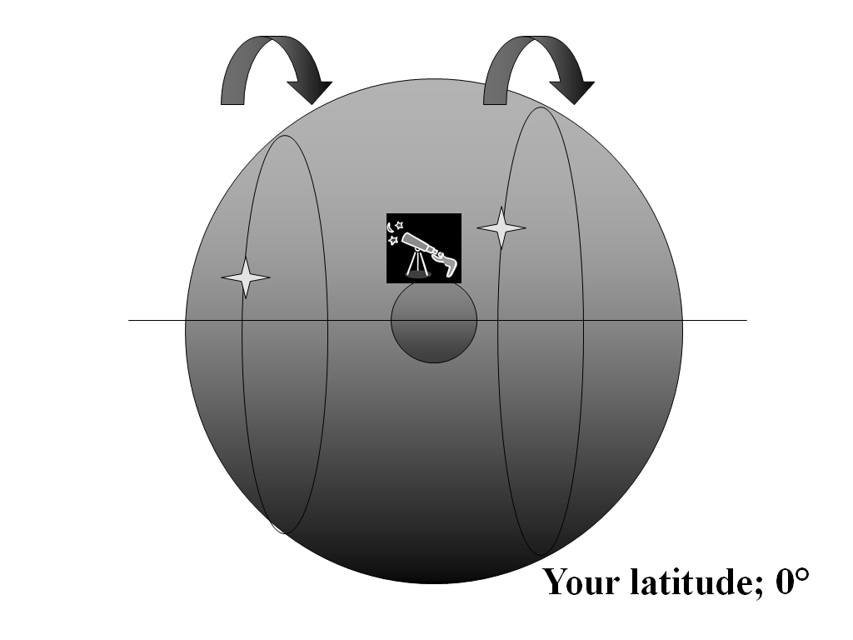
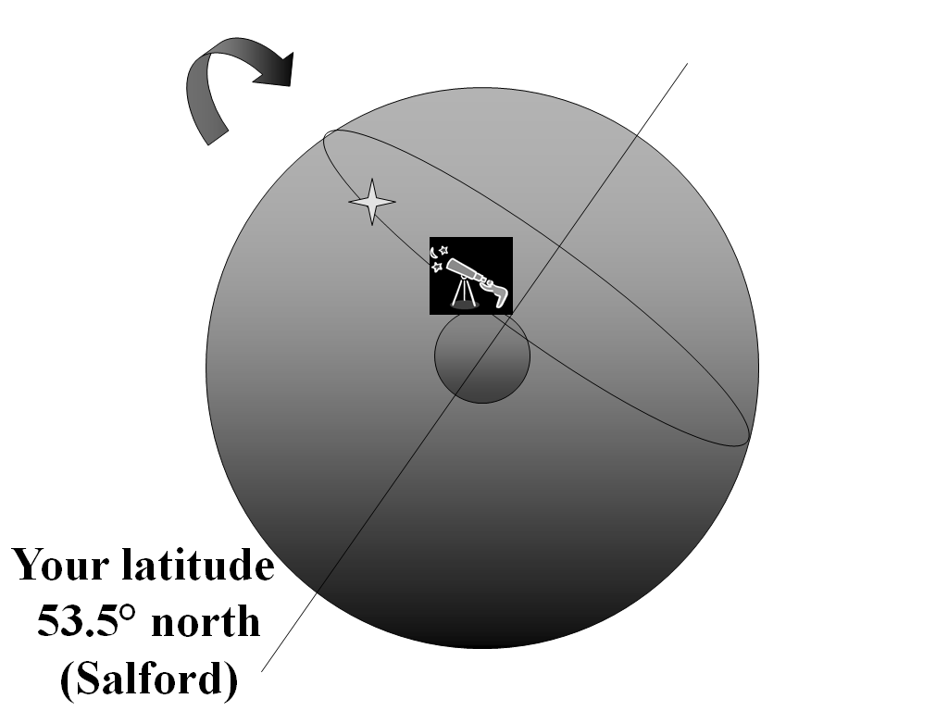
How the Sky Appears to an Observer
This depends on your location on the Earth, in particular your latitude.

Slide 6
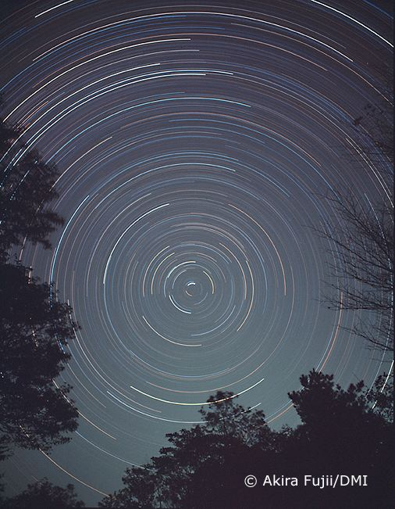
Star trails from
the northern
Hemisphere…
Notes:
Ppont out the Pole Star

Slide 7
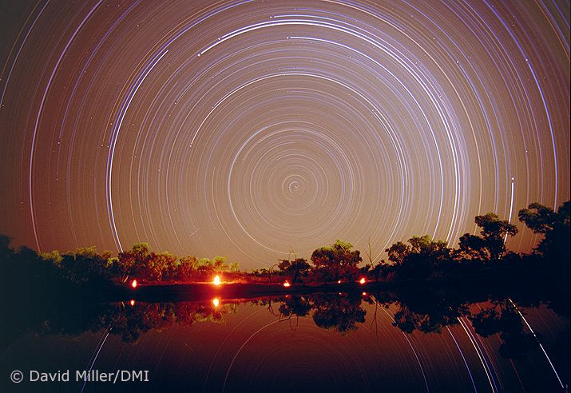
… and from the
southern hemisphere
Notes:
Point out the lack of a southern pole star.

Slide 8
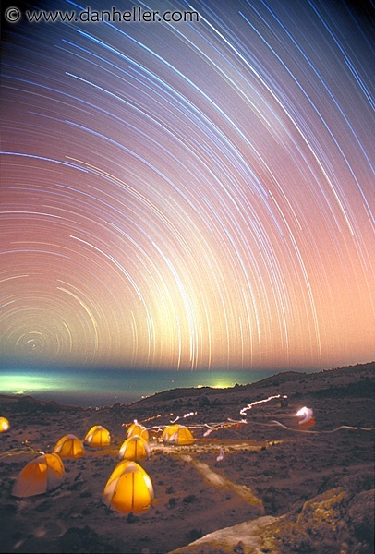
Star trails from
Kilimanjaro
Lat. ≅ 3° South

Slide 9
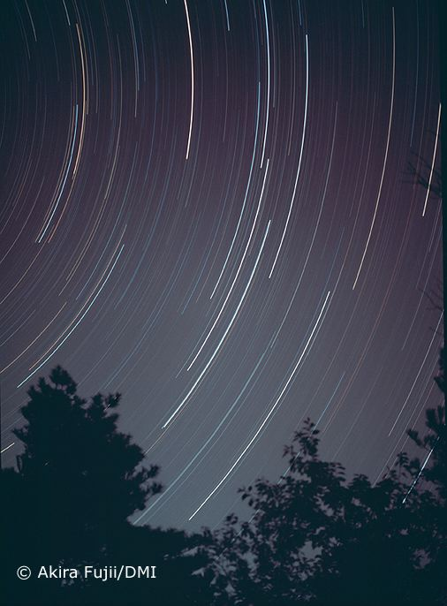
Stars of the Plough
rising in the east

Slide 10
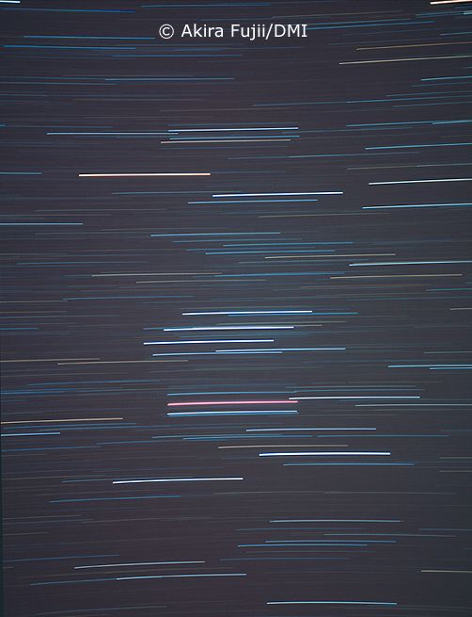
Stars of Orion
moving across the
southern part of
your sky

Slide 11
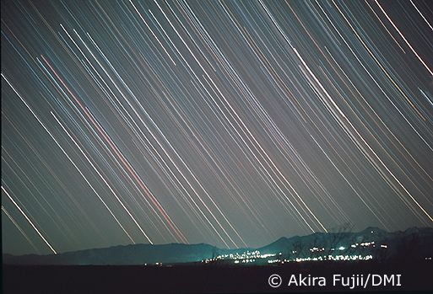
Stars of Orion
setting in the west

Slide 12
You can only see half of the
Celestial Sphere at any one time

Slide 13
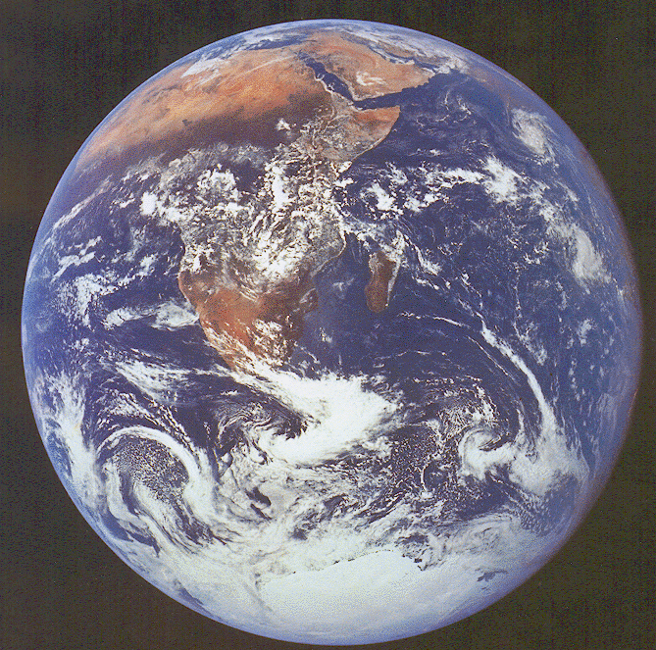
Notes:
This tries to show why you only see half of the celestial sphere

Slide 14
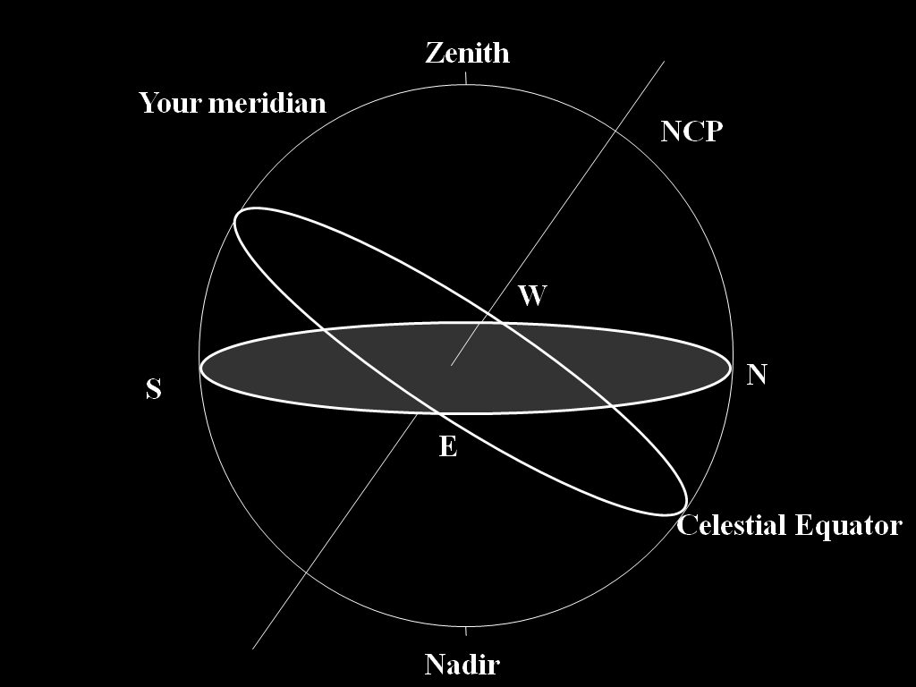
Your meridian
Notes:
Mention zenith, nadir and meridian and also the four compass points

Slide 15
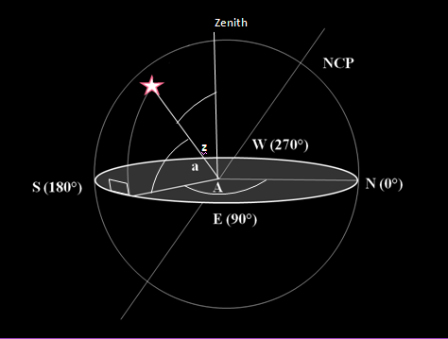
Defining Altitude ‘a’
and Azimuth ‘A’
Notes:
Mention zenith distance; a and A changing all the time.

Slide 16
A star attains its maximum altitude
when it is crossing the meridian – this
is called culmination or southing

Slide 17
Culmination or
southing
S

Slide 18
Star on meridian
(culmination)

Slide 19
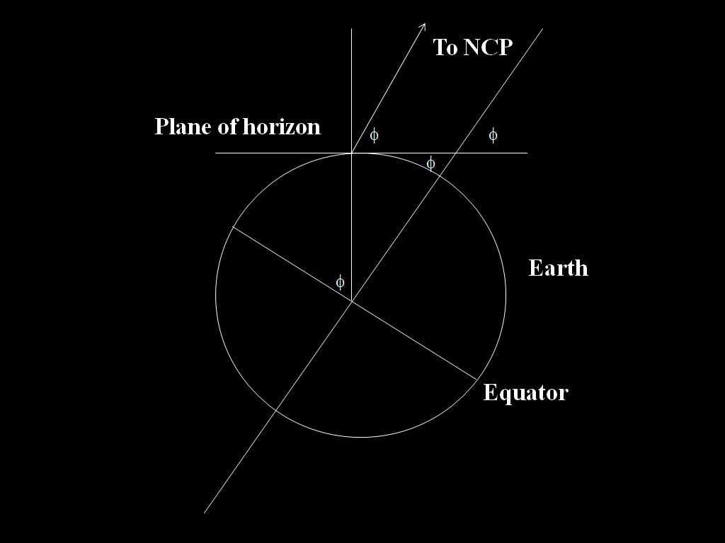
The altitude of
the celestial pole
is equal to
your latitude

Slide 20
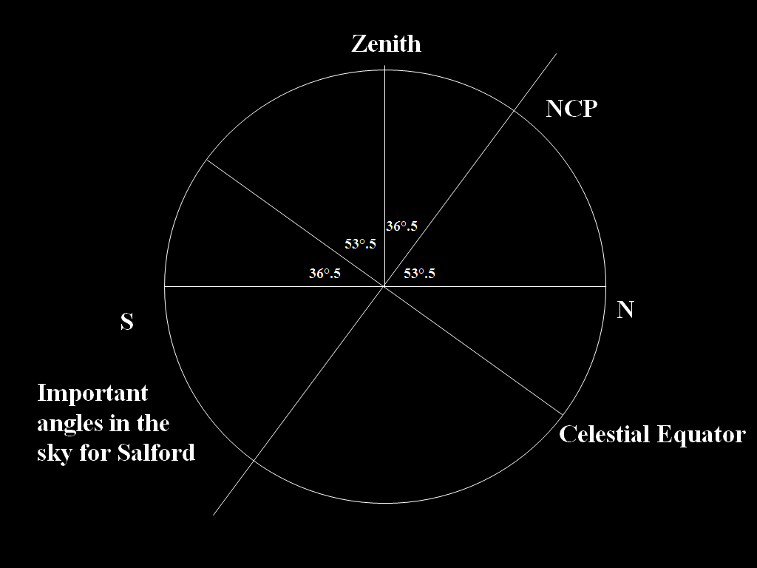
Salford:
Latitude 53°.5 North
Plane of
horizon
36°.5

Slide 21
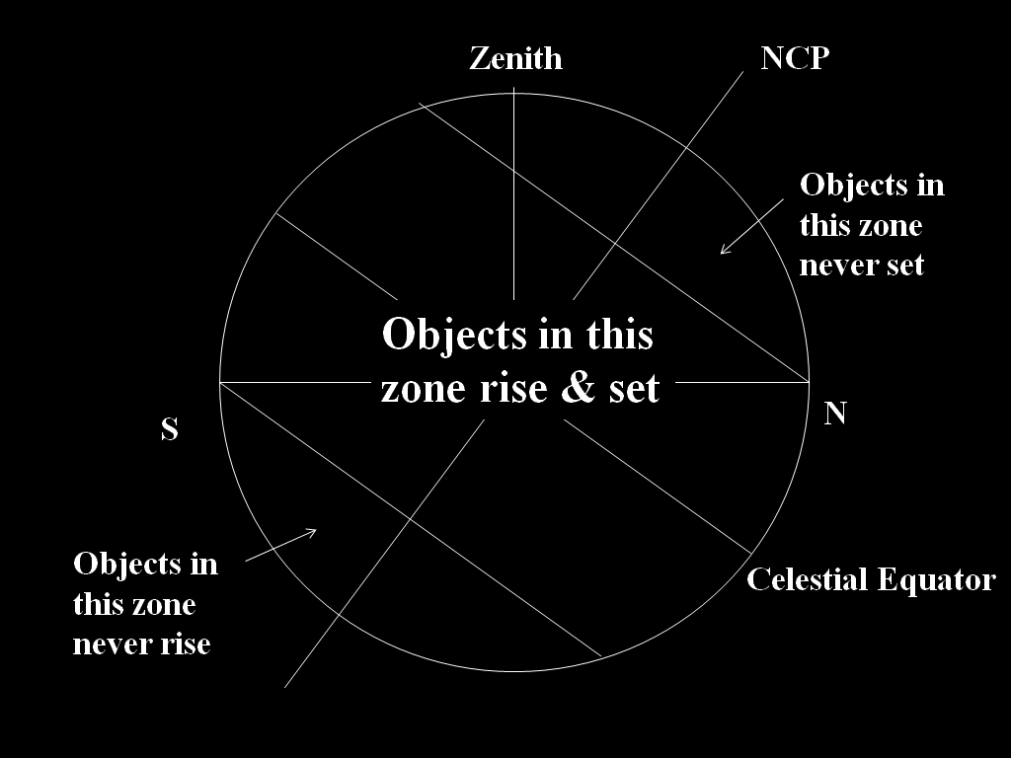
Circumpolar
stars
Plane of
horizon

Slide 22
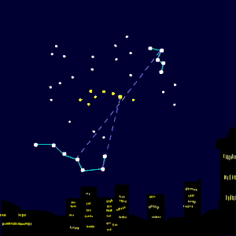
Upper culmination
Lower culmination
N

Slide 23
Equatorial Coordinates 1
Declination – ‘δ’ – Dec. An object’s angular
distance north or south of the celestial equator
Measured in °, ‘, “ of arc
‘+’ – northerly declination
‘-’ – southerly declination

Slide 24
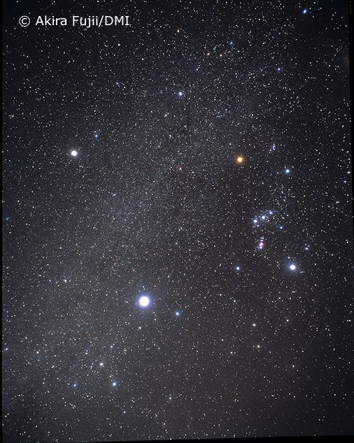
can tell us an object’s maximum
Altitude (or smallest zenith distance)
Example:
Sirius has a southerly declination of 16° 43’.
This means that its altitude at culmination in Salford is;
36° 30’ - 16° 43’ = 19° 47’.

Slide 25
Zenith
NCP
Sirius
16° 43’
19° 47’
53°.5
S
N
Celestial Equator

Slide 27
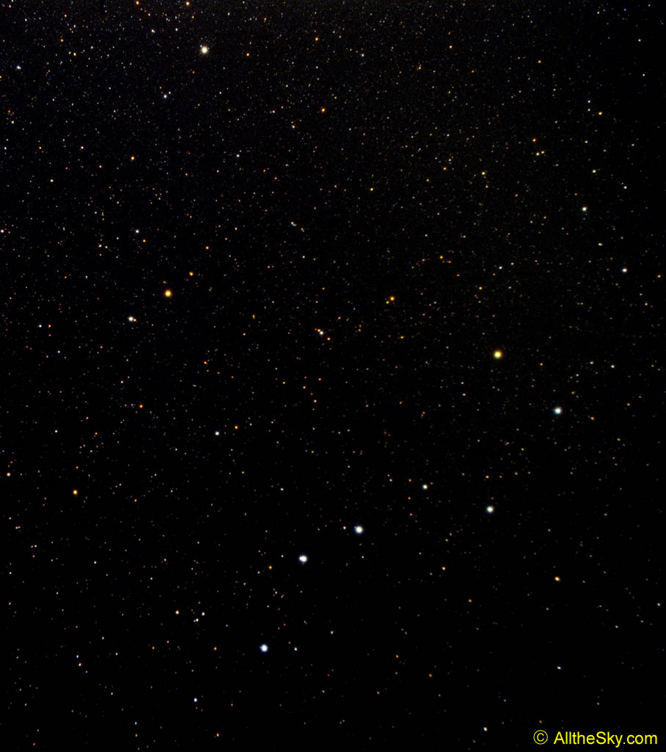
For the star Mizar in the Plough, δ = 54° 56’:
So ‘a’ at (upper culmination) = 36° 30’ + 54° 56’ = 91° 26’ – a little to the north of the zenith

Slide 28
Zenith
Mizar
NCP
91° 26’
54° 56’
53°.5
S
N
Celestial Equator
Lower culmination?

Slide 29
Equatorial Coordinates 2
Right Ascension – ‘α’ – R.A.
Equivalent to terrestrial longitude BUT…
Measured in Hours h
Minutes m
Seconds s
of time measured eastwards
around the celestial equator

Slide 30
The Ecliptic
Earth’s orbit
as seen from
the Sun
◉
Celestial Equator
Sun’s apparent
orbit as seen
from the Earth
◉
Notes:
Next few slides show how Oh RA is defined

Slide 31
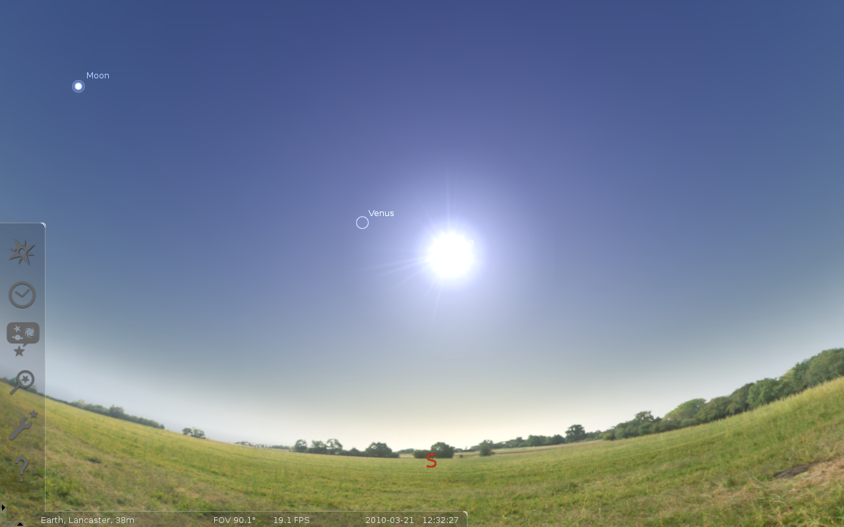
Notes:
March 21st

Slide 32
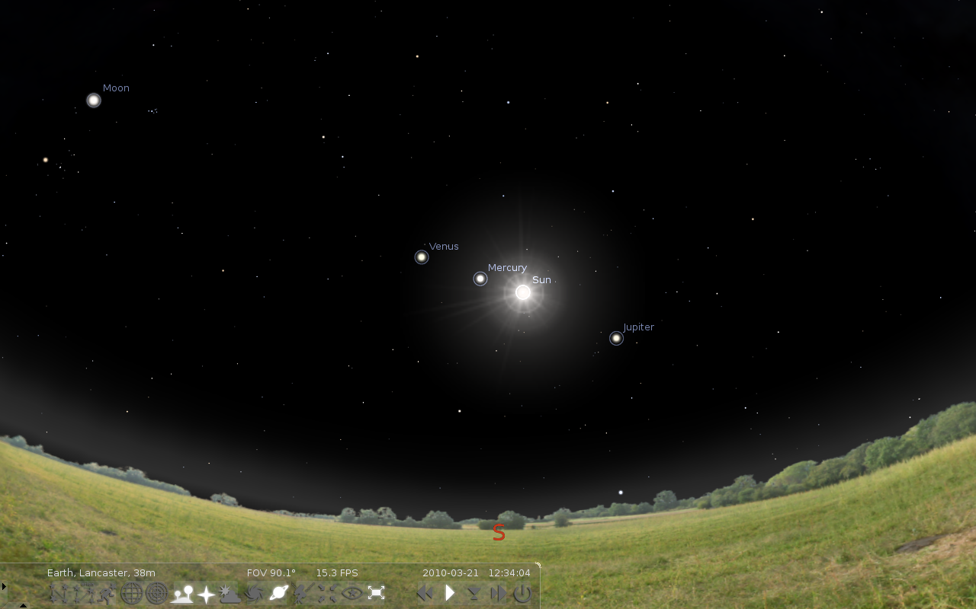
Notes:
Same shot minus sky background

Slide 33
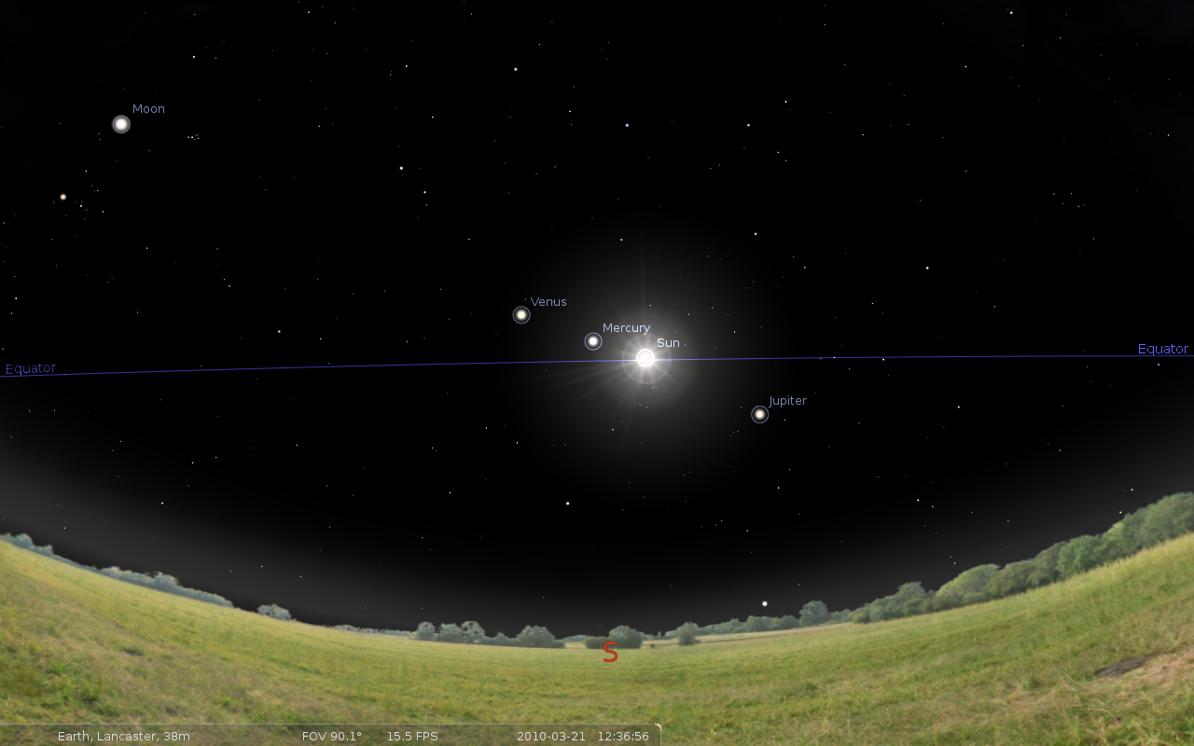
Notes:
With celestial equator

Slide 34
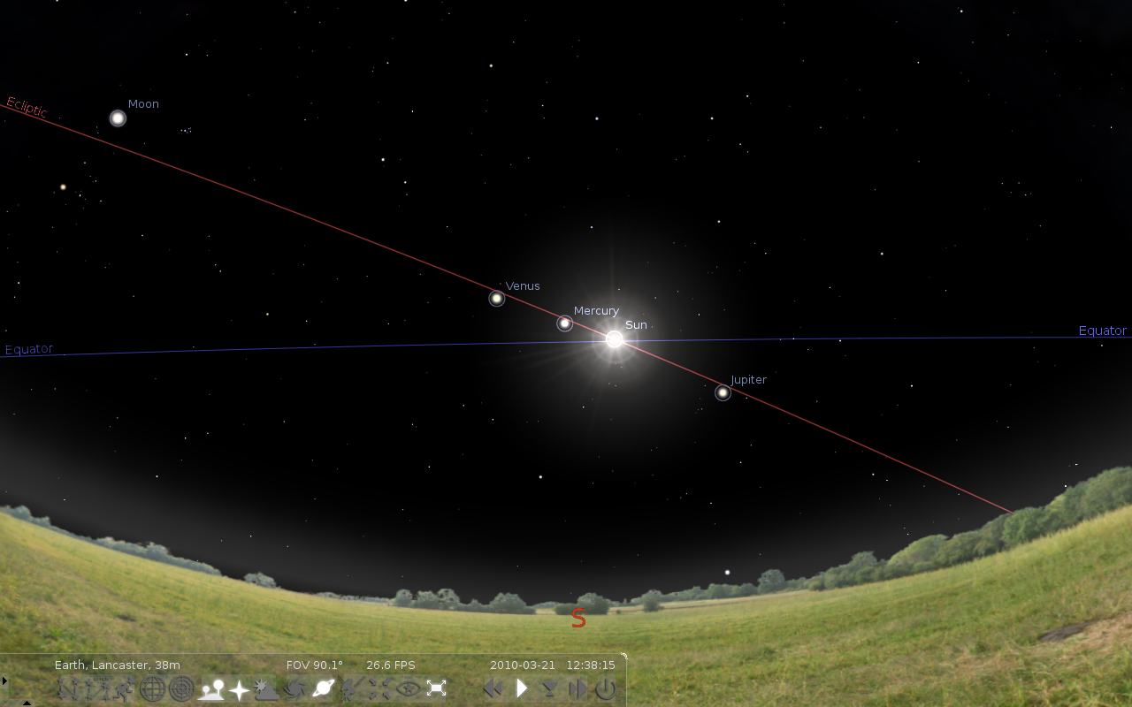
Notes:
& ecliptic – note planets lie close to ecliptic.

Slide 35
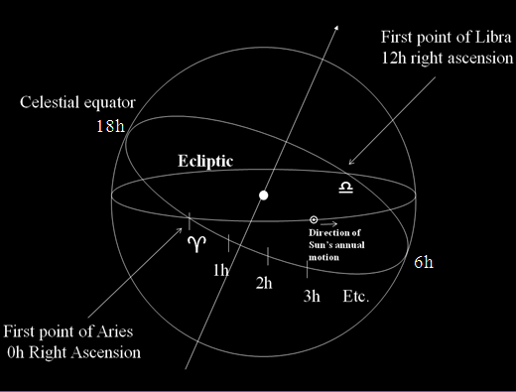
Defining Right
Ascension
ε
Notes:
Point out that in this diagram, the ecliptic is not the plane of the horizon which could be at any angle wrt the ecliptic & the CE depend on observer’s latitude.

Slide 36
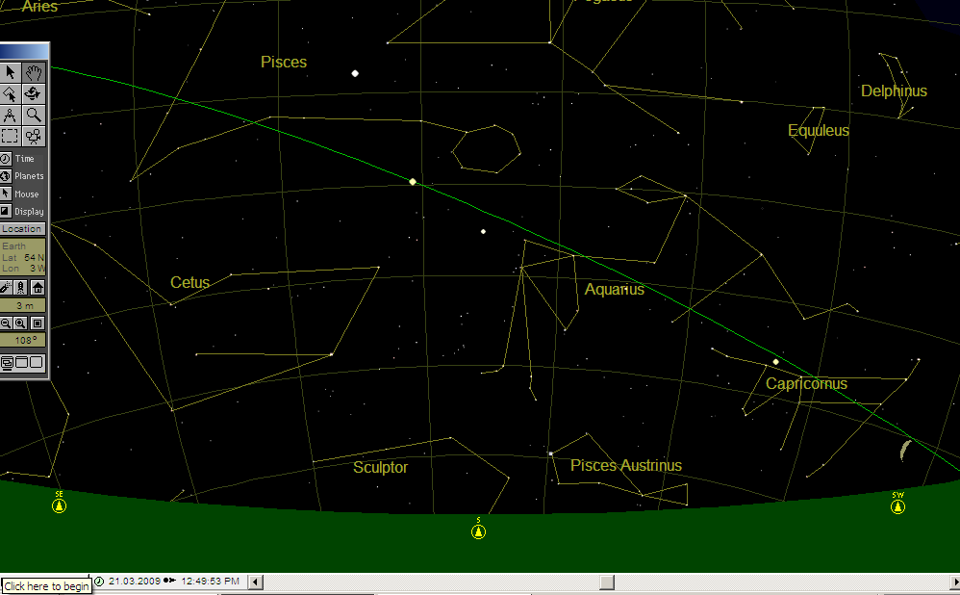
The First Point of Aries 
0°
0h

Slide 37
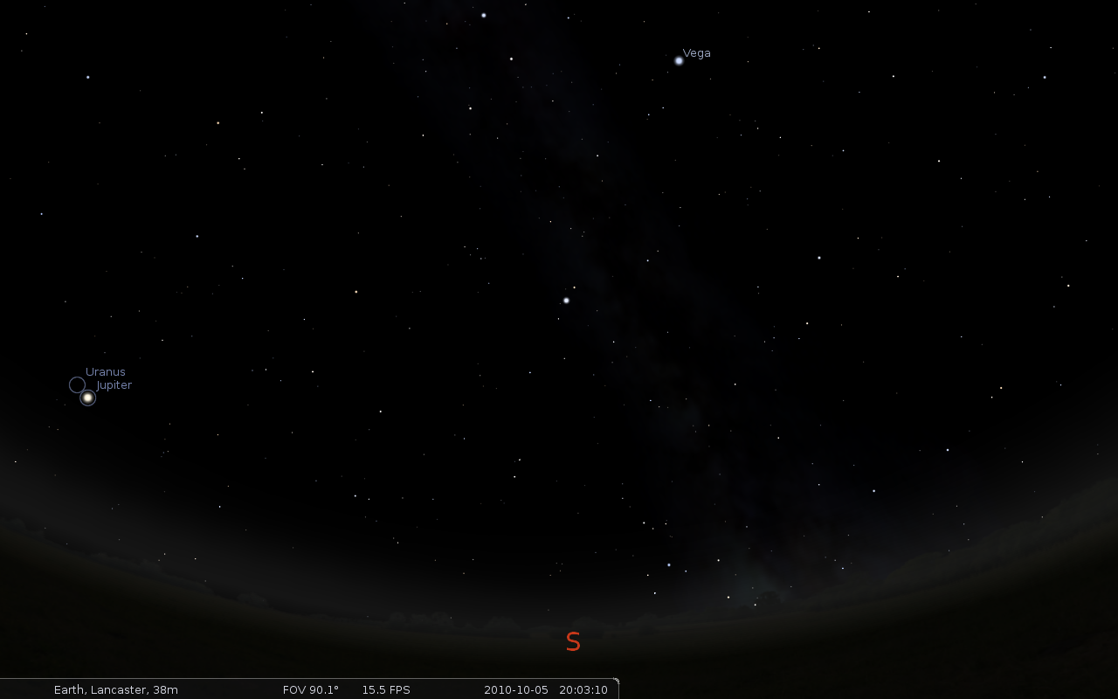
Notes:
Night sky Oct 5 – 20h

Slide 38
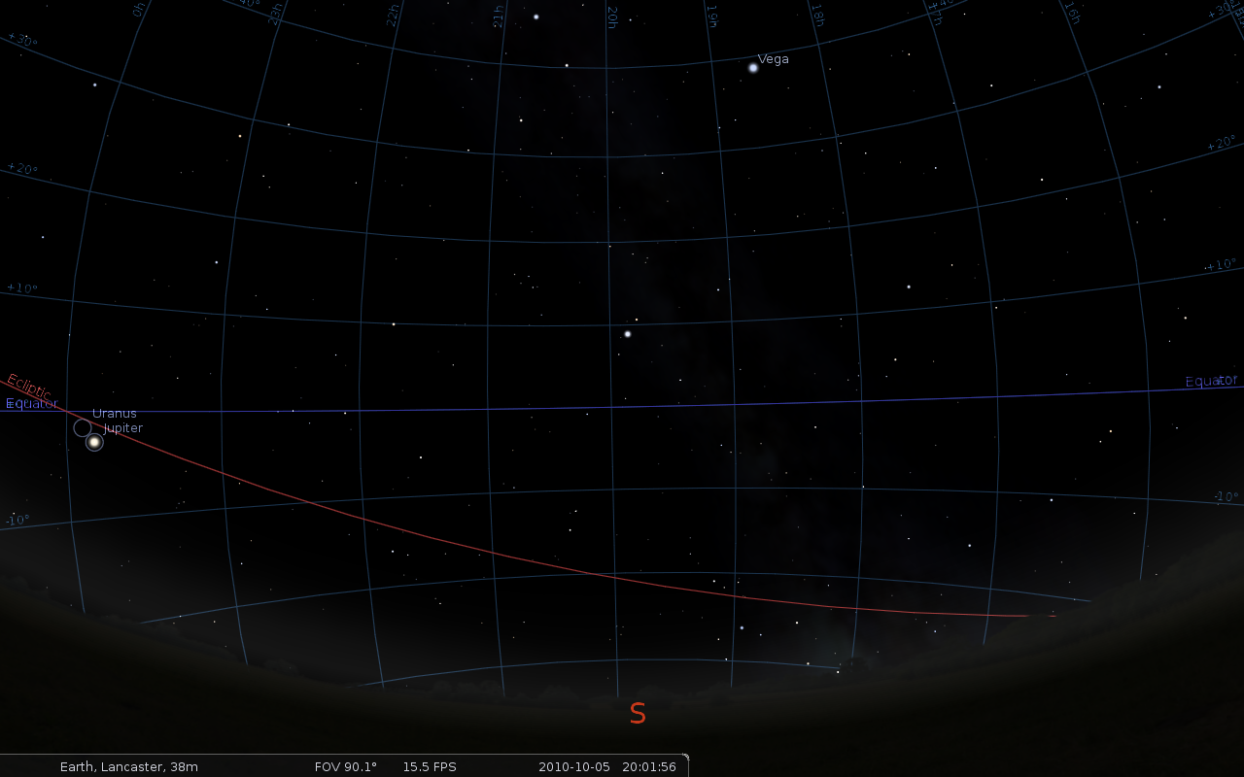
Notes:
Same scene plus coordinate grid

Slide 39
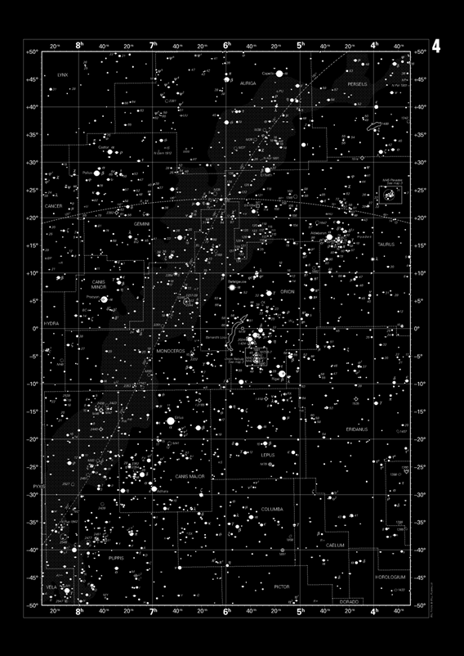
A star chart showing arcs of R.A. & Dec.

Slide 40
Local Sidereal Time
(LST)
Value of R.A.
crossing your
meridian
LST =
05h 55m
at this
instant
Betelgeuse
R.A. = 05h 55m
S
Notes:
Point out Betwelgeuse

Slide 41
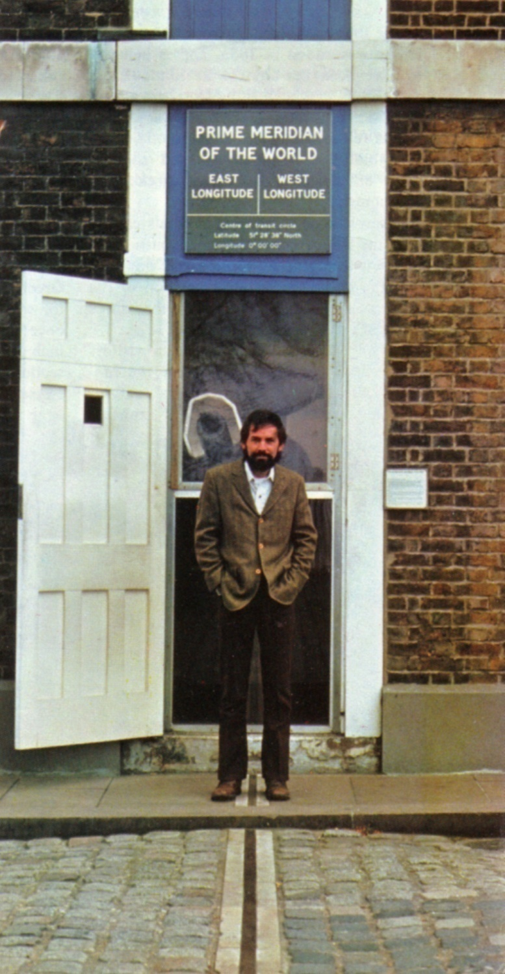
The Greenwich meridian
Longitude 0°
Here LST ≡ GST
Greenwich Sidereal Time
R.A. 24h ≡ 360°
1h ≡ 15°
Or 1° ≡ 4m
Notes:
Important – how to convert hours of RA to degrees on longitude & vice versa

Slide 42
GST vs LST for longitude l
For west longitudes: LST = GST – l (in time units)
For east longitudes: LST = GST + l (in time units)
Eg. Salford – longitude l = 2°.29 west
≡ 2°.29 × 4m = 9.16m
= 9m 10s
GST = 05h 55m – Betelgeuse on meridian at Greenwich
LST (Salford ) = 05h 55m – 9m 10s = 05h 45m 50s
Betelgeuse – east or west of Salford meridian?

Slide 43
Hour Angle H
Amount of sidereal
Time elapsed since
object was last
on meridian
H for
Betelgeuse
H = LST - α LST > α; object west of meridian
H = LST - α + 24 LST < α; object east of meridian
S
Notes:
Point out Betwelgeuse

Slide 44
Defining Right
Ascension
Notes:
Point out that in this diagram, the ecliptic is not the plane of the horizon which could be at any angle wrt the ecliptic & the CE depend on observer’s latitude.

Slide 45
Where has the horizon gone?

Slide 46
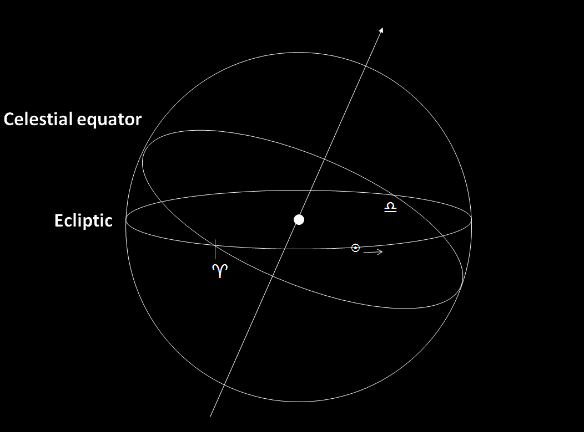

Slide 47
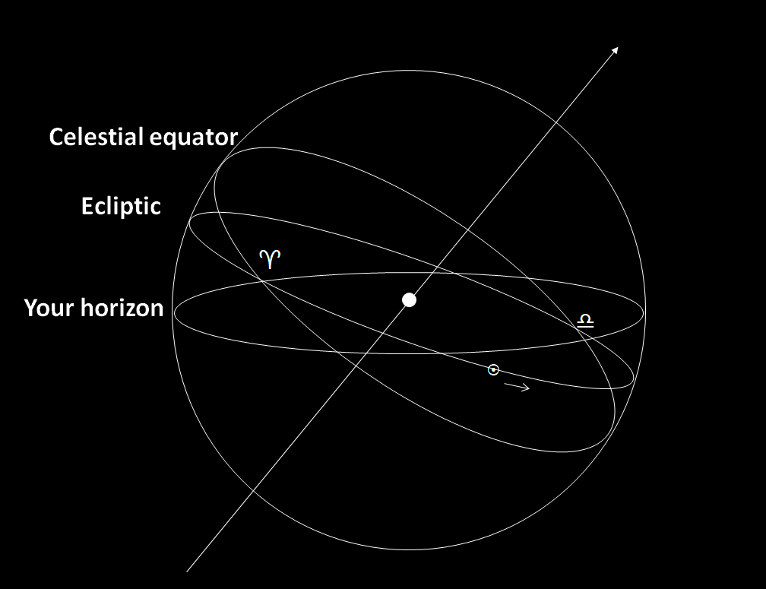

Slide 48
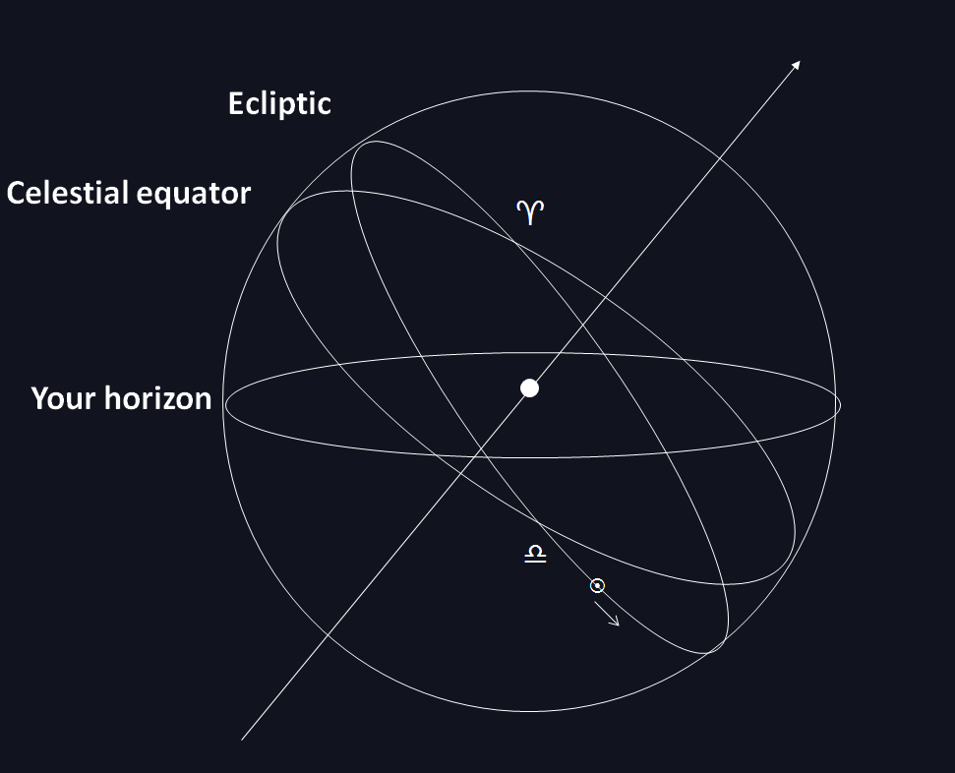

Slide 49
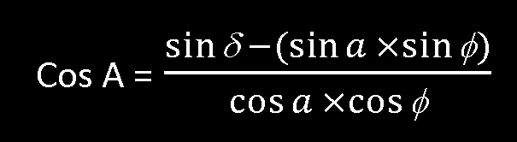
Converting R.A. & Dec. to Altitude & Azimuth
a = altitude
A = azimuth
φ = latitude
δ = declination
H = hour angle; which must be converted from sidereal time units to degrees.

Slide 50
Important:
If an object is east of the meridian, then H converted to degrees will result in sin H being -ve. The result is that A gives the true azimuth; i.e. measured in degrees eastwards from north.
For objects west of the meridian, sin H is +ve and the azimuth = 360° minus the calculated value of A. If a turns out to be –ve, this simply means that the object is below the horizon at this time.

Slide 51
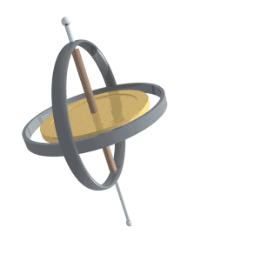
Precession & Nutation

Slide 52
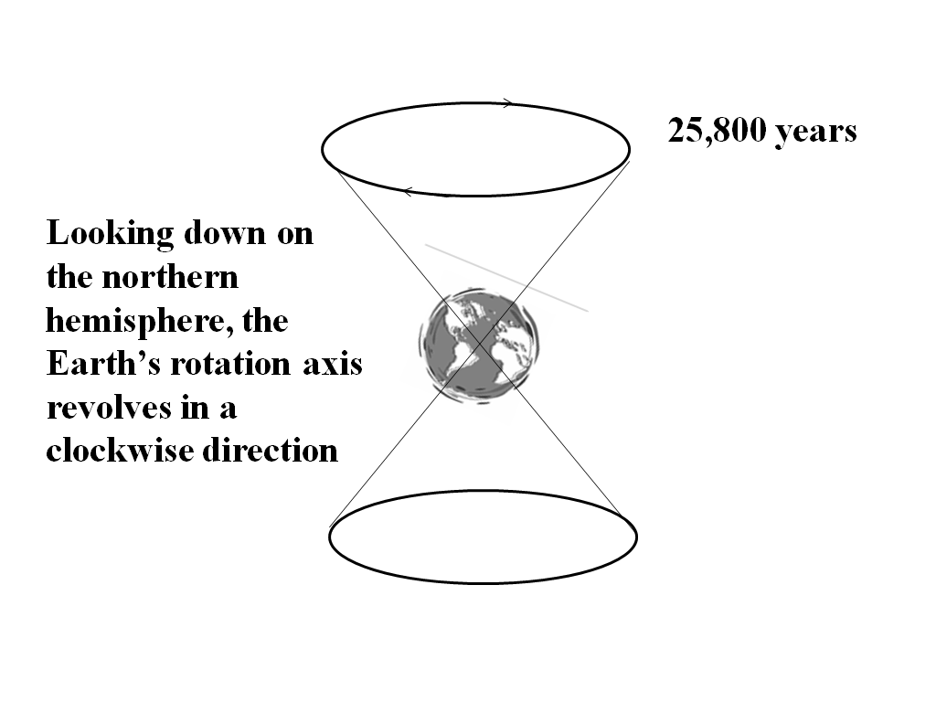

Slide 53
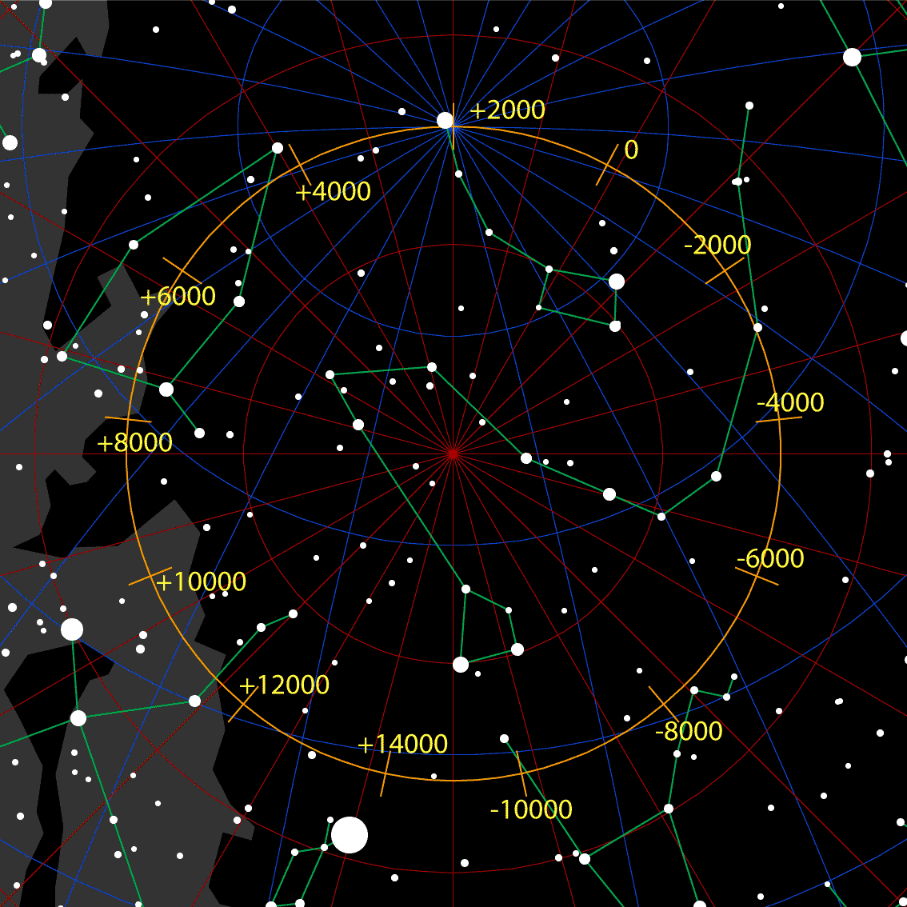

Slide 54
The First Point of Aries 
0°
360° in 25,800 years
0h

Slide 55
ε
Ecliptic
ε The Obliquity of the Ecliptic

Slide 56
Obliquity of the Ecliptic ε
(in “) = 84,381”.448 – 46”.84024T – (59” × 10⁻⁵) T² + (1”.813 × 10⁻³) T³
All numbers are in seconds; i.e. 1/3600 of a degree and T is in Julian centuries – so T = 1 means 36,525 days.

Slide 57
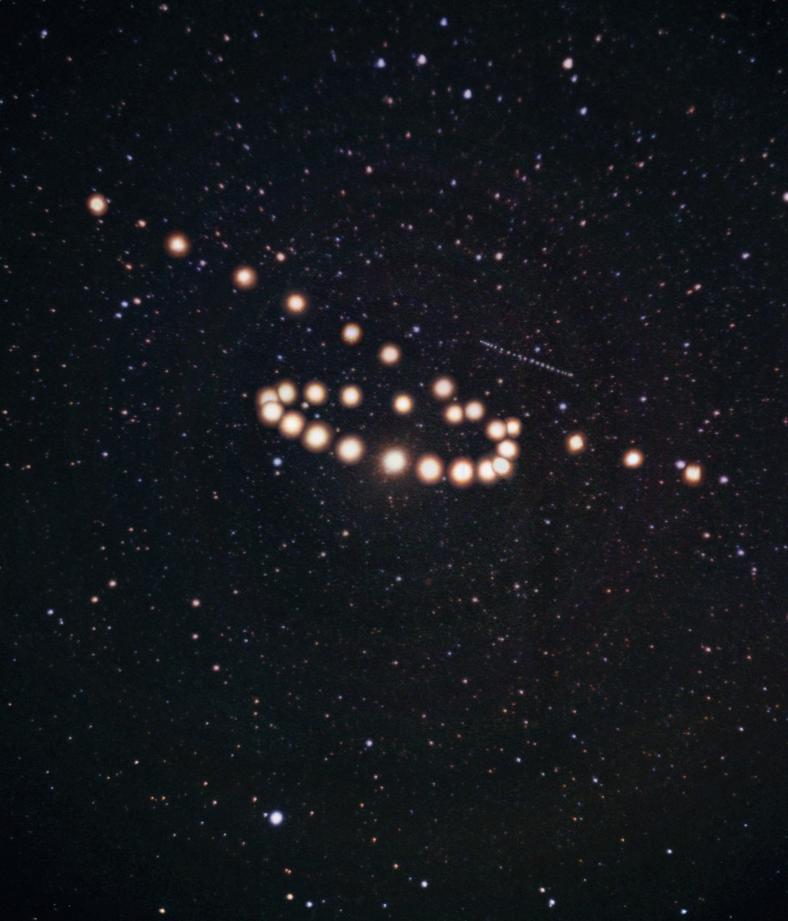
Next time –
Orbits & the Solar System

